Slide 1
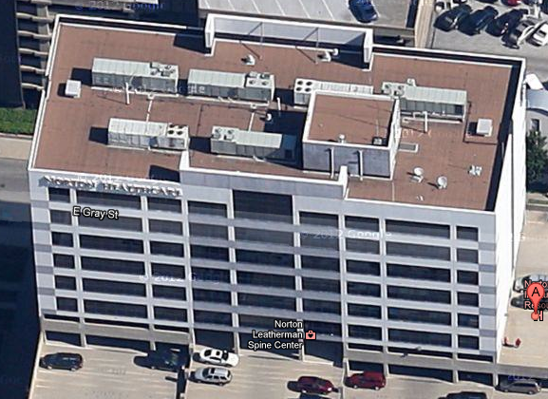
Presented to: A Louisville Hospital
Date: May 30, 2013
John Harryman
President
Andy Strausbaugh
VP Finance/Operations

Slide 2
Objective
Cut $30M From the Budget in 2013

Slide 3
Opportunity to Save…
 | Area Benefit | Annual Savings | Savings Type
LED Lights | Facilities | $1,100,000 | Reduced Energy
Ultra Violet Lights | Facilities | $1,900,000 | Reduced Energy
HotSpot | IT | $4,200,000 | Revenue Generator
De-Regulated Energy | Facilities | $1,150,000 | Reduced Energy
VOIP | IT | $1,200,000 | Reduced Fees
MPLS | IT | $1,000,000 | Reduced Fees
Cost Containment | Finance | $3,000,000 | Reduced Fees
Vendor Management | Finance | $350,000 | Reduced Overhead
Cloud Based Services | IT | $4,320,000 | Reduced Fees
Social Media Marketing | IT/Marketing | $1,000,000 | Revenue Generator
Ambulance Tracking | IT
Voice Recognition | IT | $1,200,000 | Reduced Overhead
Wealth Management | Finance | $100,000 | Reduced Fees
Conferencing | IT | $120,000 | Reduced Fees
Workers Comp | Finance | $4,800,000 | Reduced Fees
Benefits | Finance | $4,000,000 | Reduced Fees
Document Management | IT | $150,000 | Reduced Fees
 | Total | $29,590,000

Slide 4
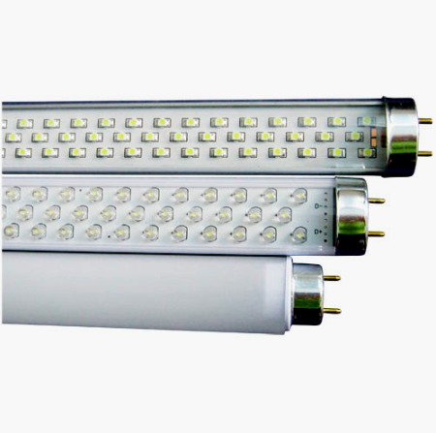
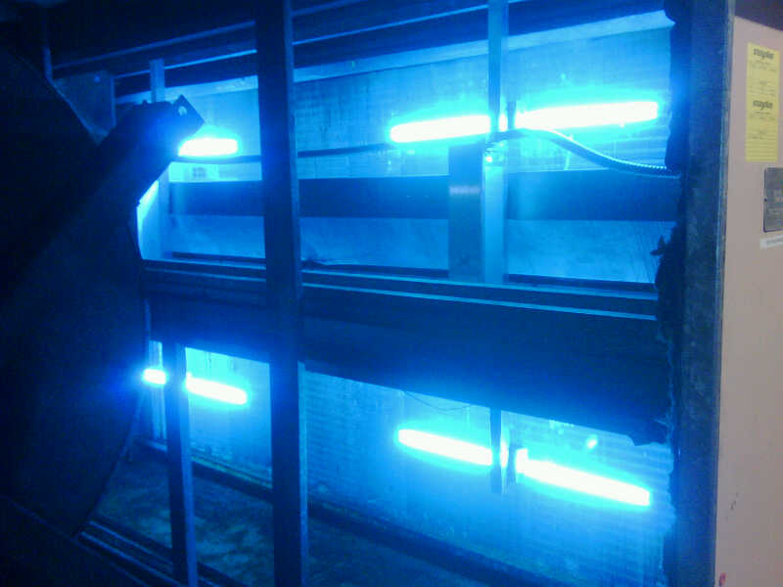
Samples

