Slide 1
The World’s Most Complete Communications System
Jamaal Savwoir
Senior VP, Sales Engineering
Principal Architect

Slide 2
E2EBA
BYOB
UC&C

Slide 3
End-to-End Blended Architecture
E2EBA
BYOB
UC&C
Notes:
E2EBA
End-to-End Blended Architecture
Constellation Advanced Voice Services Cloud
StarBox Internet Communications Appliance
Line Pooling and Line Bursting

Slide 4
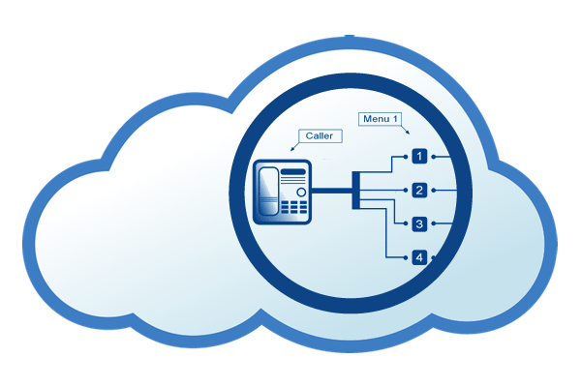
End-to-End Blended Architecture
Auto Attendant Servers
Voicemail Servers
Conferencing Servers
Remote Servers
StarFax Servers
StarCenter Advanced Call Center

Slide 5
End-to-End Blended Architecture
Edge traffic shaping
Dual WAN capable
Performance monitoring
Remote management
Local survivability
Solid state device
Low power consumption
StarBox Lite
StarBox 2250
StarBox 5500

Slide 6
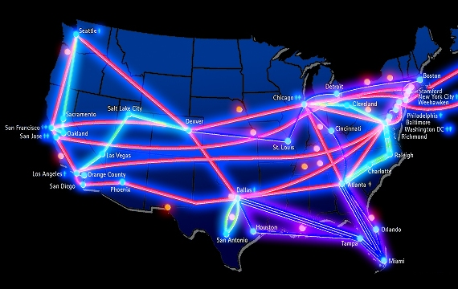
End-to-End Blended Architecture
Line pooling across locations
Line bursting on demand

Slide 7
End-to-End Blended Architecture
BYOB
Bring Your Own Broadband
UC&C
Notes:
BYOB
Bring Your Own Broadband
Multi-Stage Voice Quality Assurance
StarNet Analyzer
StarPath
Traffic Shaping
StarWatch Call Quality Monitoring

Slide 8
Bring Your Own Broadband
Multi-Stage Voice Quality Assurance
StarNet Analyzer
StarPath
Traffic Shaping
StarWatch Call Quality Monitoring

Slide 9
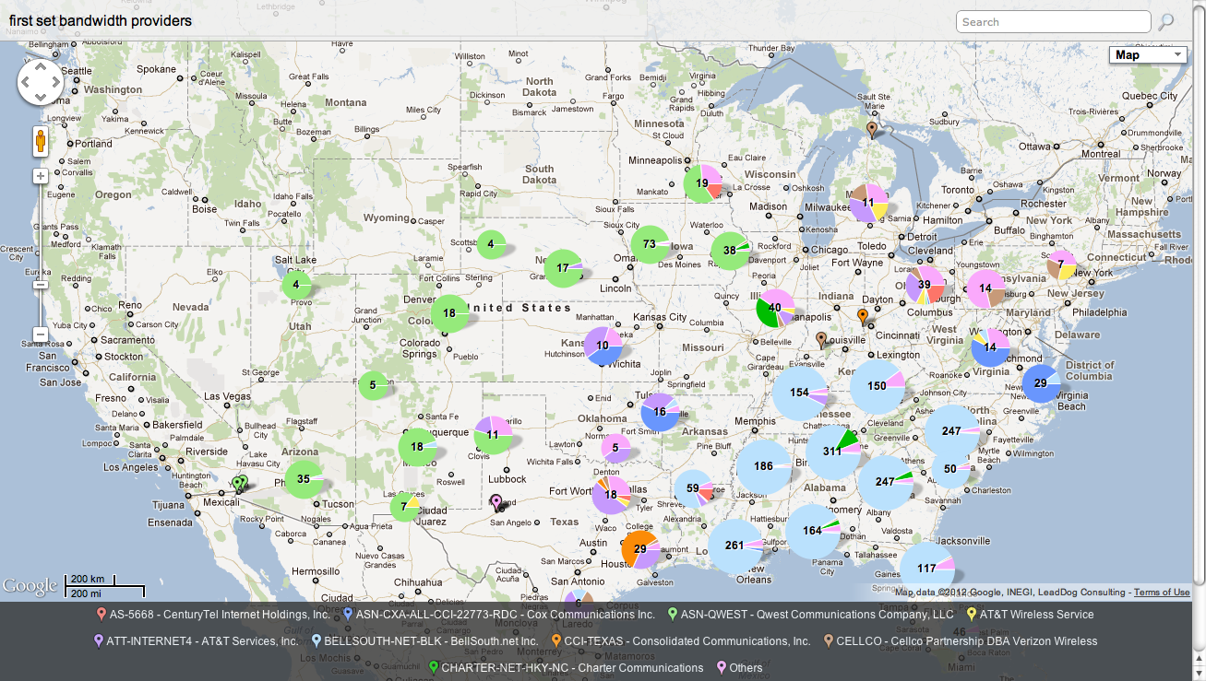
Bring Your Own Broadband
Multi-Stage Voice Quality Assurance
StarNet Analyzer
StarPath
Traffic Shaping
StarWatch Call Quality Monitoring

Slide 10
Bring Your Own Broadband
Multi-Stage Voice Quality Assurance
StarNet Analyzer
StarPath
Traffic Shaping
StarWatch Call Quality Monitoring

Slide 11
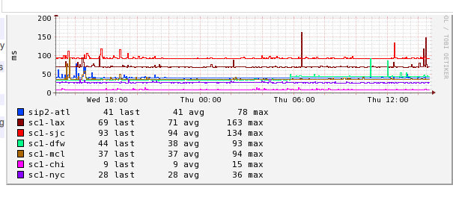
Bring Your Own Broadband
Multi-Stage Voice Quality Assurance
StarNet Analyzer
StarPath
Traffic Shaping
StarWatch Call Quality Monitoring

Slide 12
End-to-End Blended Architecture
Bring Your Own Broadband
UC&C
Unified Communications & Collaboration
Notes:
UCnC
Unified Communications and Collaboration
Orion UCnC Applications Cloud
StarScope 2 Presence and Call Control
StarPhone for iPhone
StarFax Personal
Activities
StarVideo, StarChat, FirstContact

Slide 13
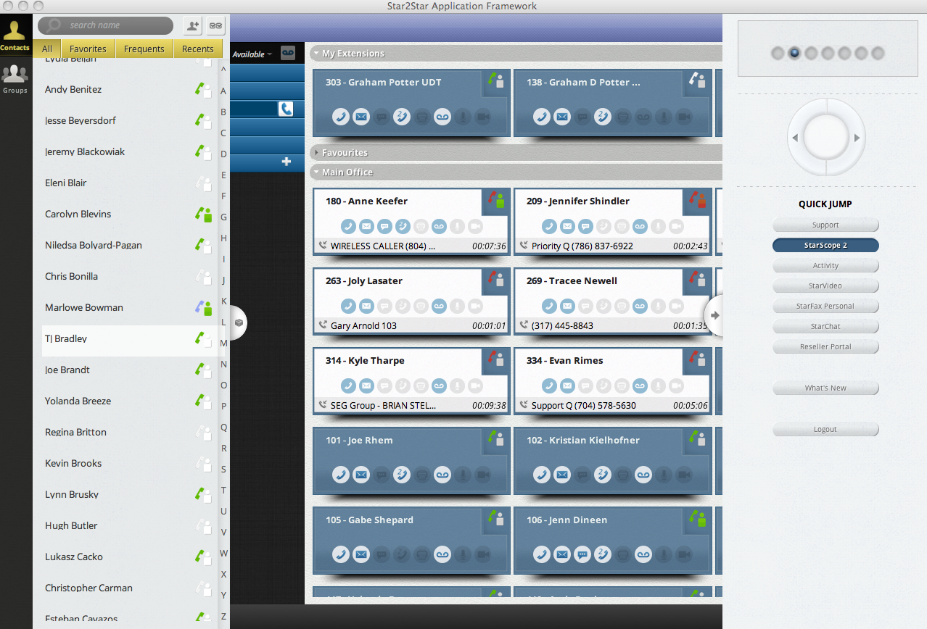
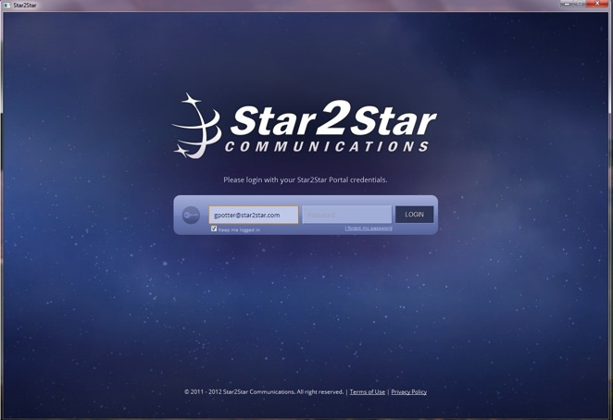
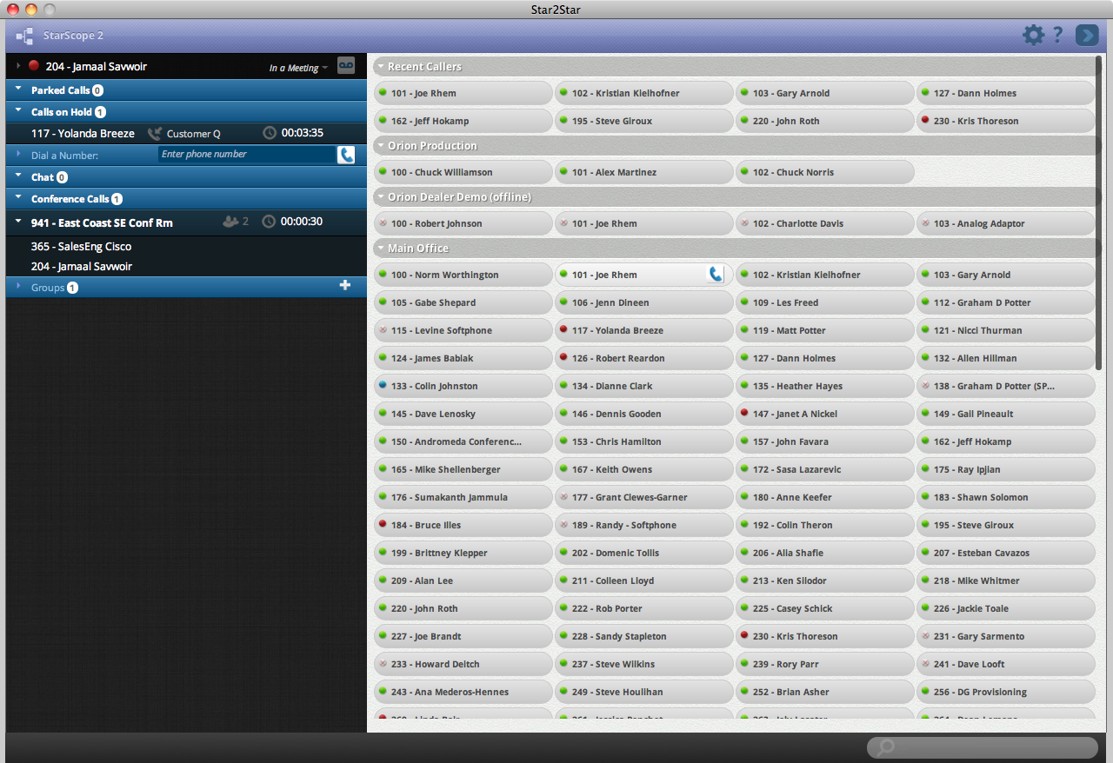
Unified Communications & Collaboration
Orion UC&C Applications Cloud
StarScope 2
Presence and Call Control
StarPhone for iPhone
StarFax Personal
Activities
StarVideo, StarChat

Slide 14
Unified Communications & Collaboration
Orion UC&C Applications Cloud
StarScope 2
Presence and Call Control
StarPhone for iPhone
StarFax Personal
Activities
StarVideo, StarChat

Slide 15
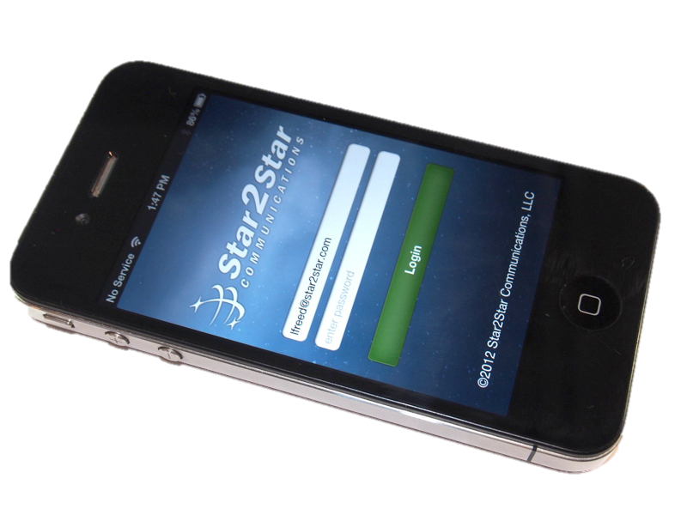
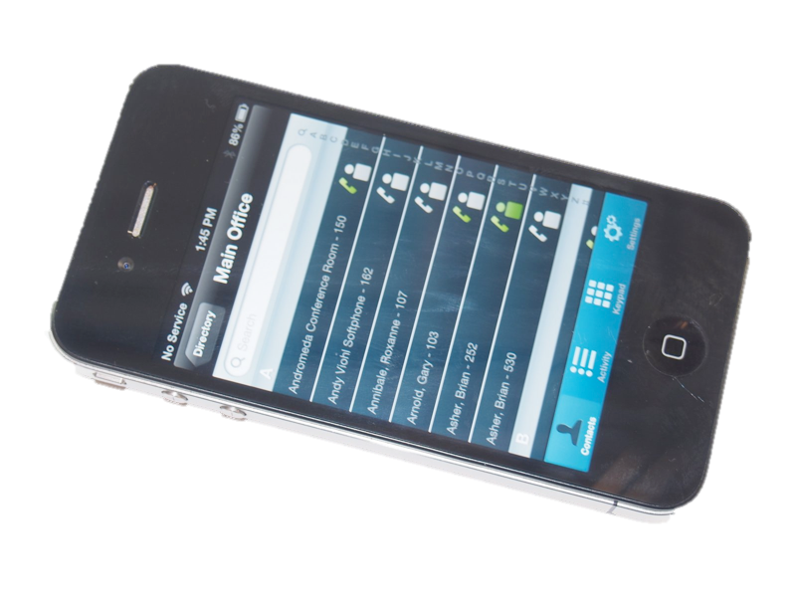
Unified Communications & Collaboration
Orion UC&C Applications Cloud
StarScope 2
Presence and Call Control
StarPhone for iPhone
StarFax Personal
Activities
StarVideo, StarChat

Slide 16
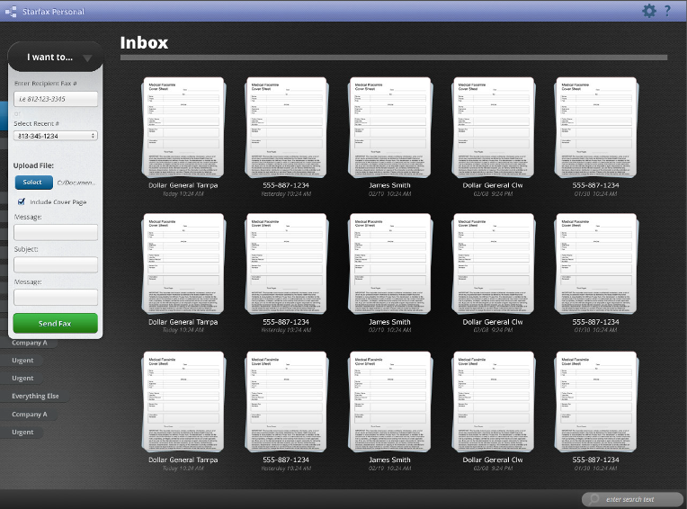
Unified Communications & Collaboration
Orion UC&C Applications Cloud
StarScope 2
Presence and Call Control
StarPhone for iPhone
StarFax Personal
Activities
StarVideo, StarChat

Slide 17
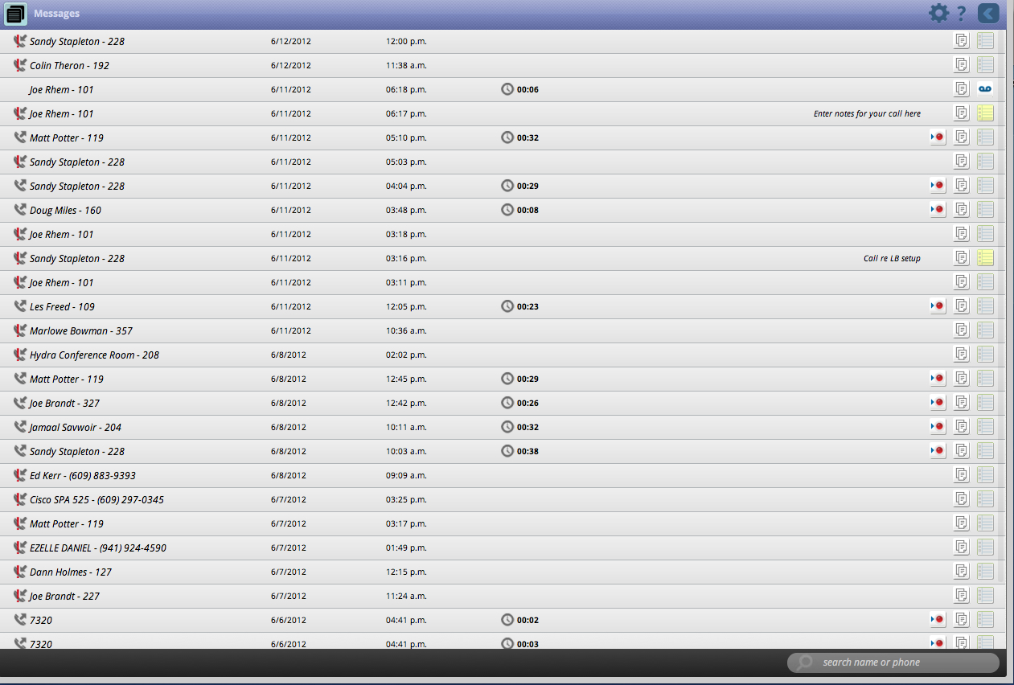
Unified Communications & Collaboration
Orion UC&C Applications Cloud
StarScope 2
Presence and Call Control
StarPhone for iPhone
StarFax Personal
Activities
StarVideo, StarChat

Slide 18
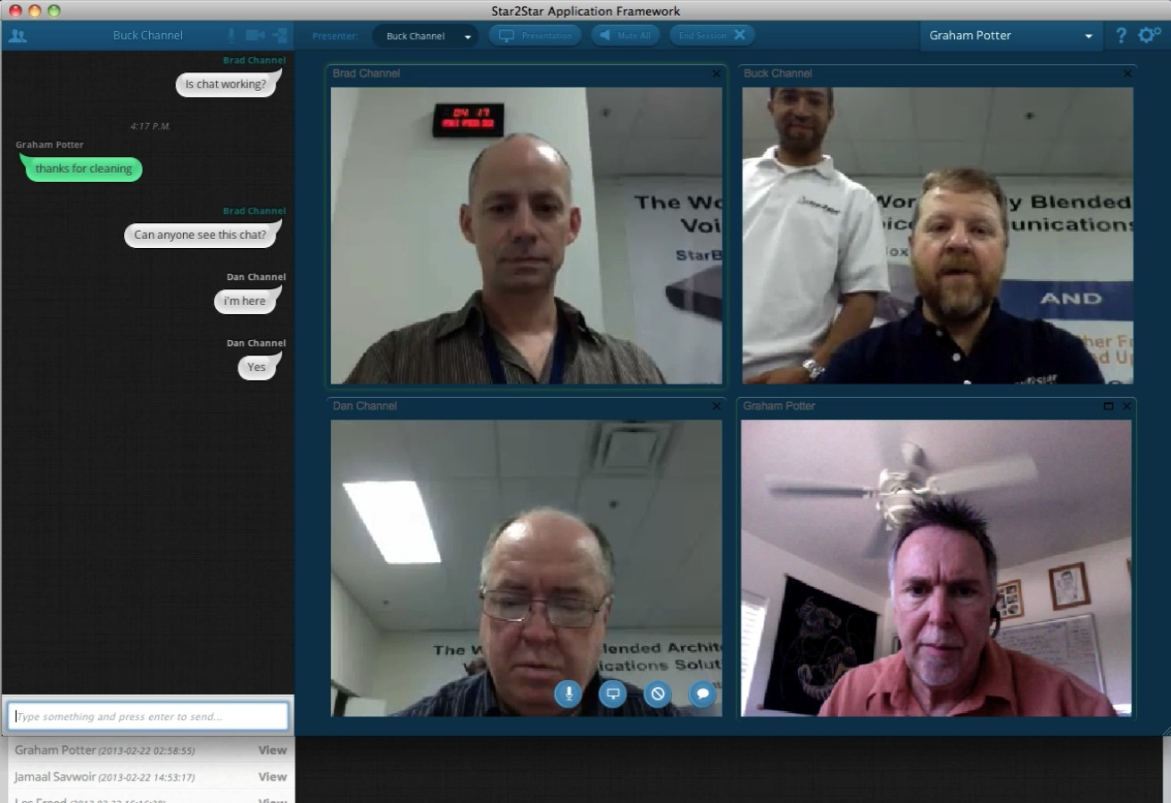
Unified Communications & Collaboration
Orion UC&C Applications Cloud
StarScope 2
Presence and Call Control
StarPhone for iPhone
StarFax Personal
Activities
StarVideo, StarChat

Slide 19
End-to-End Blended Architecture
Bring Your Own Broadband
Unified Communications & Collaboration
Notes:
UCnC
Unified Communications and Collaboration
Orion UCnC Applications Cloud
StarScope 2 Presence and Call Control
StarPhone for iPhone
StarFax Personal
Activities
StarVideo, StarChat, FirstContact

Slide 20
/company/star2star-communications-llc
/star2star @star2star
/star2star

