Slide 1
Understanding MHO
| June 4, 2013

Slide 2
Agenda
Who is MHO Networks?
MHO Services
MHO’s Value
Core Network
Microwave Technology
Network Coverage
Questions to Think About
Service Level Agreements (SLA’s)
Common Questions and Concerns
Installation Process
Testimonials
SPIFF

Slide 3
Who is MHO Networks?
Denver-based Data Solutions provider offering high-speed data services
Purpose: To provide primary or diverse high-speed Dedicated Internet Access and Metro Ethernet solutions.
Established in 1991
ISP since 1994 and WISP since 1997

Slide 4
MHO Services
Dedicated Internet
10 Mbps up to 4Gbps
Metro Ethernet
10 Mbps up to 1Gbps
Ethernet Private Line
Ethernet Virtual Private Line
Ethernet LAN
Combined Internet and Metro-E
10 Mbps up to 4 Gbps

Slide 5
MHO Services
MHO at the Following Data Centers

Slide 6
MHO’s Value
MHO is “The Alternative” to terrestrial carriers
To Your Customer:
Fiber or EoC are not Viable Options
Fast and/or Guaranteed Installation is a must
Best form of “true” diversity
To You:
Become a trusted solution source to your customer
Include MHO up front in your quotes
Your order will get installed

Slide 7
Core Network
100% Wireless
100% Ethernet
Fully Meshed
MPLS
Open Shortest Path First (OSPF)

Slide 8
Microwave Technology
Point to Point Microwave
Dedicated Bandwidth
SLA’s similar to getting fiber
Point to Multi-Point
Shared Bandwidth
Typically Best Effort

Slide 9
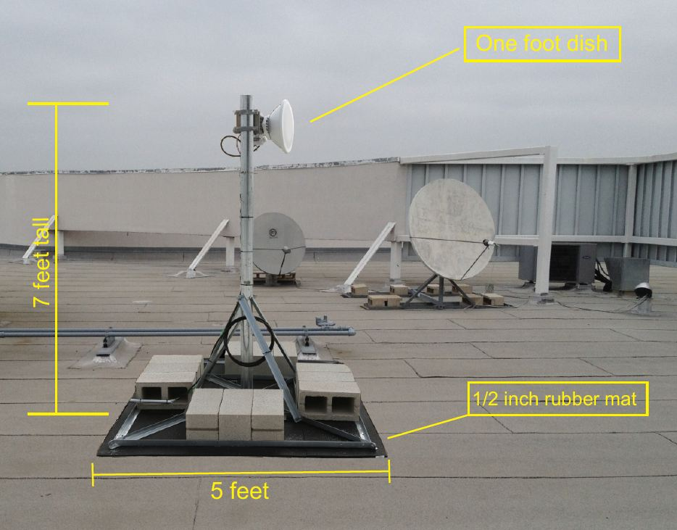
Non Penetrating Install

Slide 10
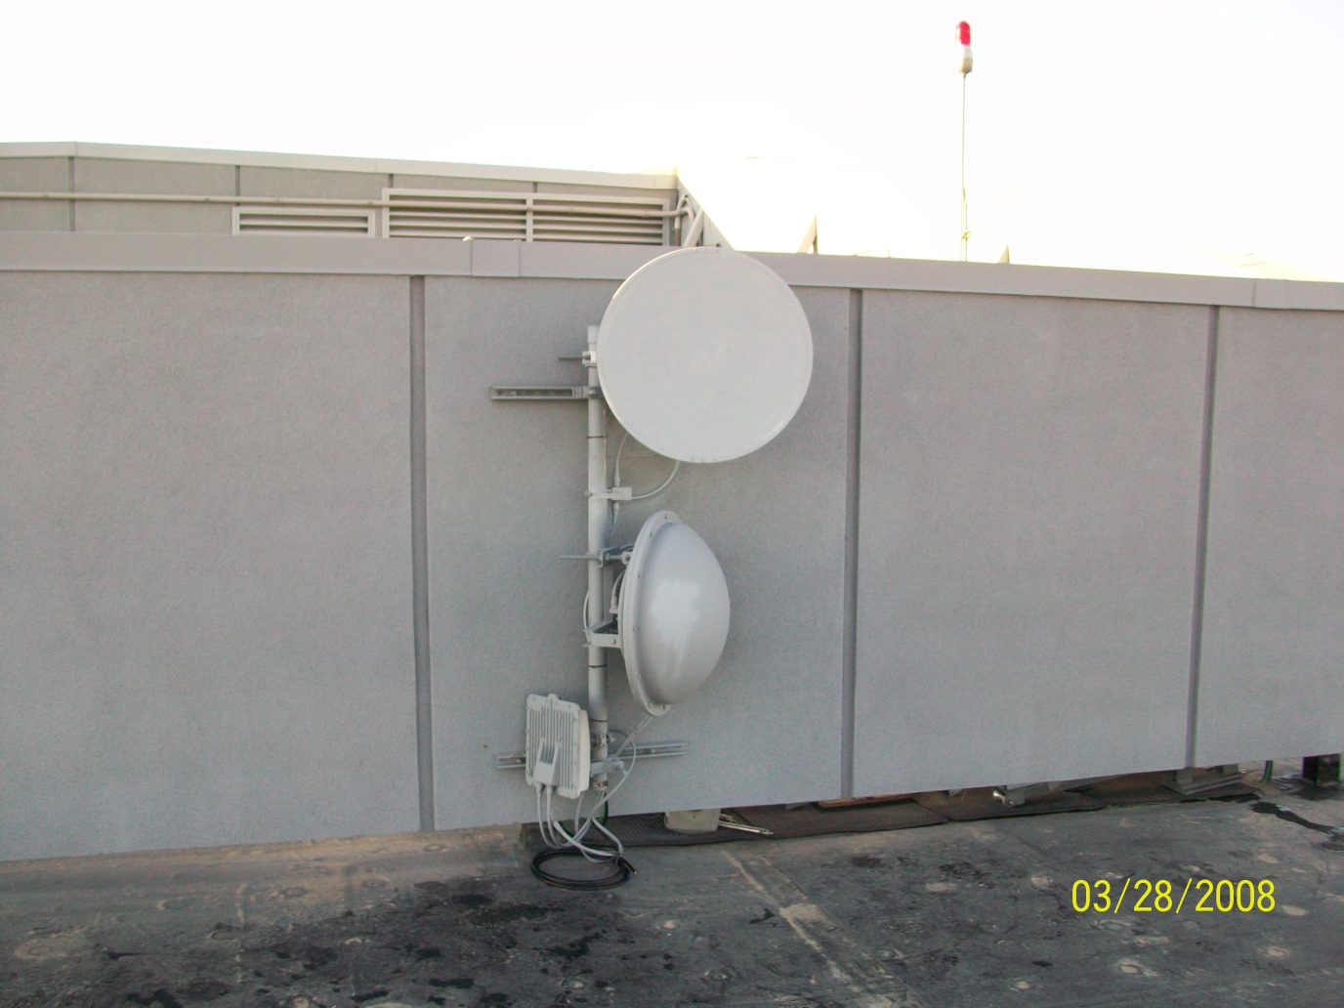
Wall Mount Install

Slide 11
MHO Network Coverage
CA - Orange County and the Inland Empire
LA/Santa Monica – by end of 2nd Qtr 2013
Colorado

Slide 12
Service Level Agreement (SLA)
Installation
10Mbps – 500Mbps – 10 business days
1Gbps - 4 Gbps – 20 business days
Availability
Dedicated Internet – 99.99%
Metro Ethernet -- 99.99%
Repair
Two hour repair guarantee
Latency
An average of 45ms or less

Slide 13
Questions to Think About
Along with some standard terrestrial solutions, are you open to considering an Enterprise fixed wireless solution?
If you discover getting a terrestrial solution poses a challenges to meeting you needs, would you then consider a fixed wireless solution?
If getting a high speed terrestrial solution is NOT an option or poses to be a challenge, how might that impact your company? What’s your plan B?

Slide 14
Common Questions and Concerns
Inclement Weather
No issues as the network is fully redundant and fault tolerant
Adaptive Modulation
Reliability
The network is designed and built to 99.99% availability.
Security
Proprietary and AES encryption are built into every radio. The US Military uses the same Motorola radios for their missions – very secure.
Latency
The core network has typical latency of >2ms, end to end latency >5ms.
VoIP (either SIP or Hosted PBX) and other latency sensitive applications will run successfully

Slide 15
Installation Process
Set Installation Date with Client
Site Survey – approx. 2-3 days prior to installation
MHO pulls cable from roof to phone closet
MHO Installs power supply in phone closet
Phone Closet - Smart Jack - Ethernet Handoff
Radios tested to ensure solid connection
Customer notified via email service is installed and ready for turn up
Client Extends cabling from Smart Jack to their network room

Slide 16
Testimonial
“MHO has been fantastic for Jefferson County. We wanted a wireless connection for our secondary ISP link and MHO has proven their worth on several occasions. Whether it be notifying us before we even know there's a problem, to upgrading our hardware for improved performance and scalability, MHO has been solid. Our primary ISP recently had a failure and MHO was able to provide on-demand bandwidth to bridge the gap, in a couple minutes. MHO has also been a great solution for some of our remote locations for WAN connectivity. I highly recommend MHO.”
Mike Ferguson – Network Administrator Jefferson County

Slide 17
Testimonial
“We initially bought our 50 Mbps MHO connection to provide redundancy and eliminate our "backhoe problem". We felt true diversity can only be accomplished through a non-terrestrial service. We have been very pleased with the service. Installation was fast and easy: 2 weeks as opposed to 6-8 weeks with fiber. MHO's wireless data service has proven so reliable and the latency is so low that we no longer consider it our secondary connection. Now we use both our terrestrial and our wireless connection equally for daily operations. We have confidence in MHO's reliability, the service has lived up to its SLAs, and we would use MHO again. ”
Vince Larson Clear Choice

Slide 18
Case Study
Mortgage/Loan Company
Location – Anaheim, CO
VP of IT given very short notice for their move – less than 2 weeks.
Opening New Call Center with 120 agents
TWT and AT&T could not install circuits in time
MHO Solution
100Mbps Ethernet Private Line
Installed in 4 days
Customer pushes VoIP between buildings

Slide 19
$1,000 Reasons to Try MHO
Earn $1,000 for DIA or ME Sale at least $1,200 MRC
2 or 3 Year Term
May 1 – August 31, 2013

Slide 20
Questions and Thank You

