Slide 2
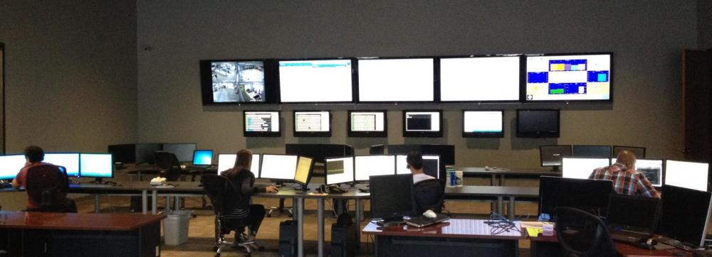
Who We Are
X2nSat is a communications carrier that owns and operates a satellite network designed specifically for business.

Slide 3
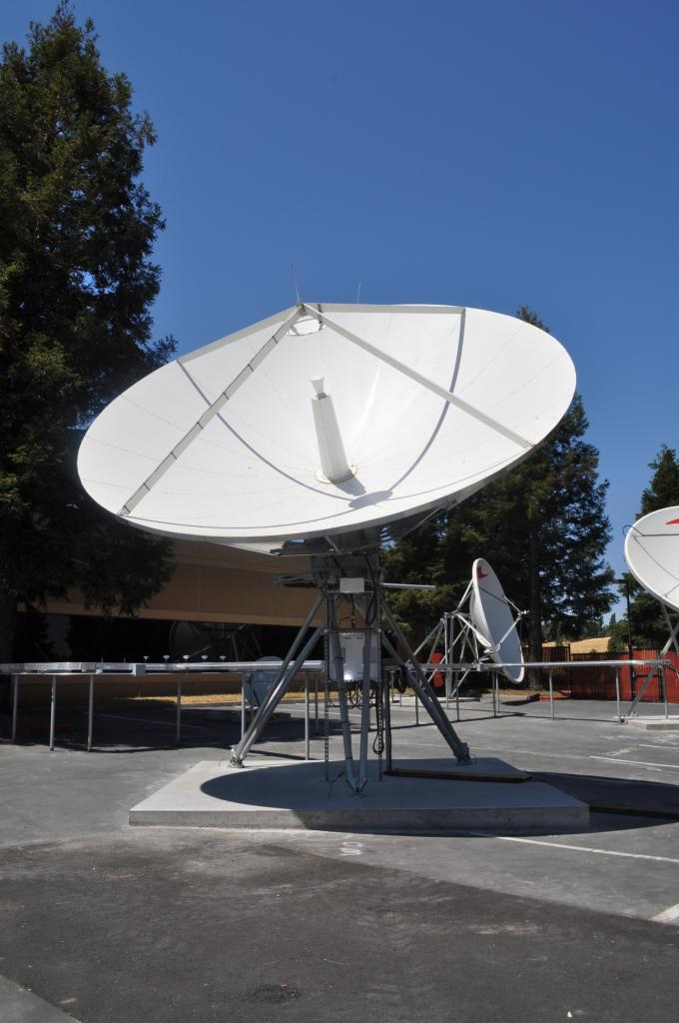
What We Do
High Speed Internet connections
Secondary connections used for Business Continuity
Economical “always On” connectivity for Point of Sale (POS) systems
Voice Circuits (VoIP or T1)
Small antenna services for data gathering, such as smart grid, solar farm, utility companies, etc.

Slide 4
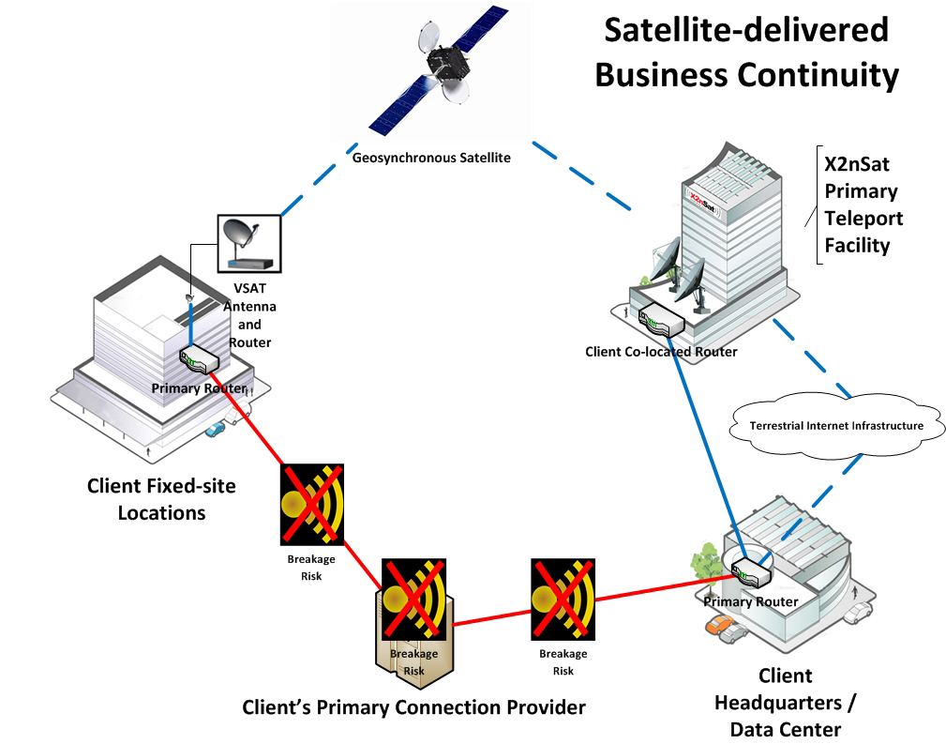
How It Works
Remote equipment has a standard Ethernet interface with IP address
All data is sent to the Petaluma Teleport in California
Data is either put onto the Internet or routed to the clients MPLS or private network

Slide 5
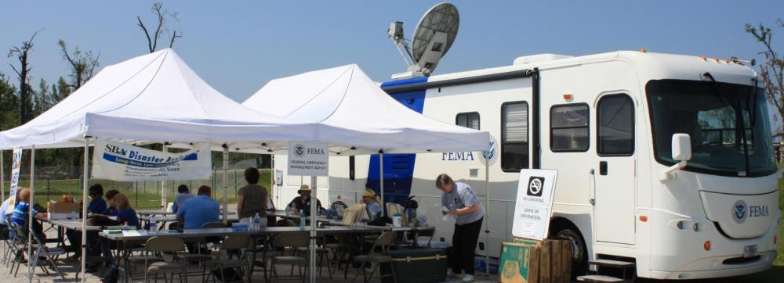
Examples
HCA – Business Continuity for the Medical Community
Hurricane Sandy – You still get to your Cloud Data when terrestrial networks fail
What are you going to tell congress?

Slide 6
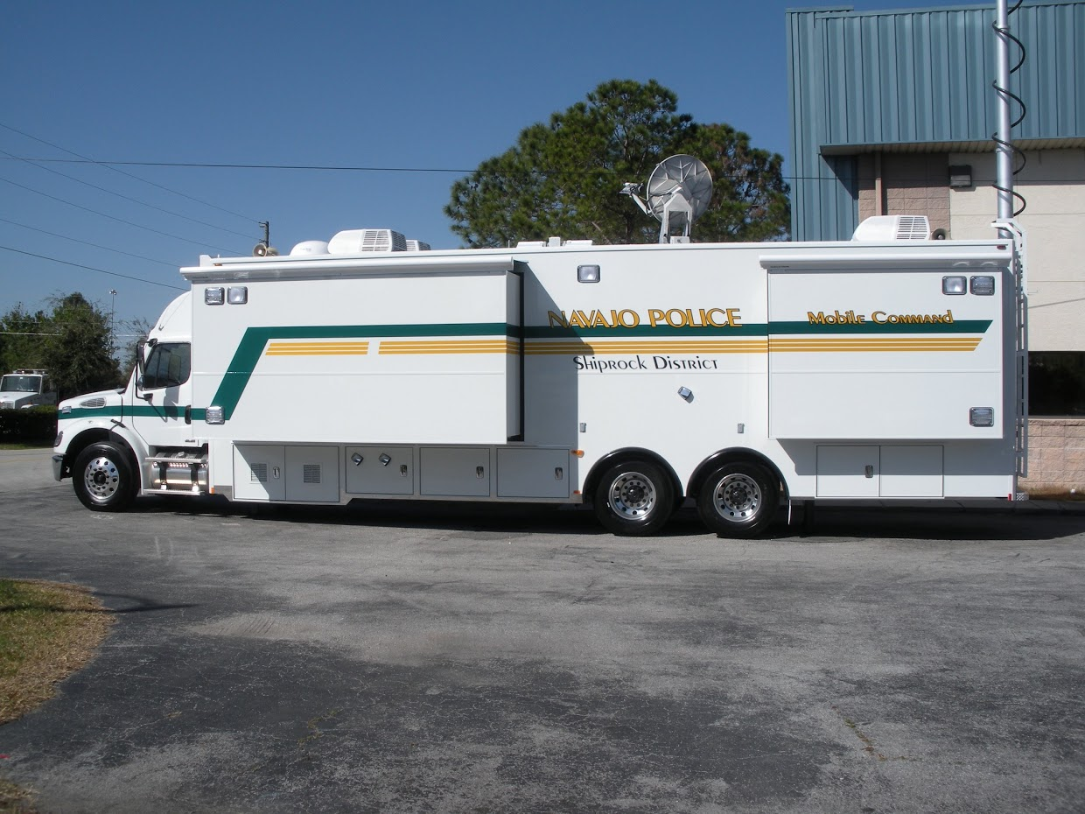
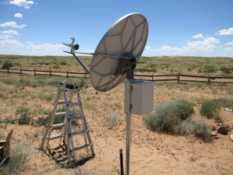
Questions
What have you heard about satellite and how can we better help you understand what we do?

Slide 7
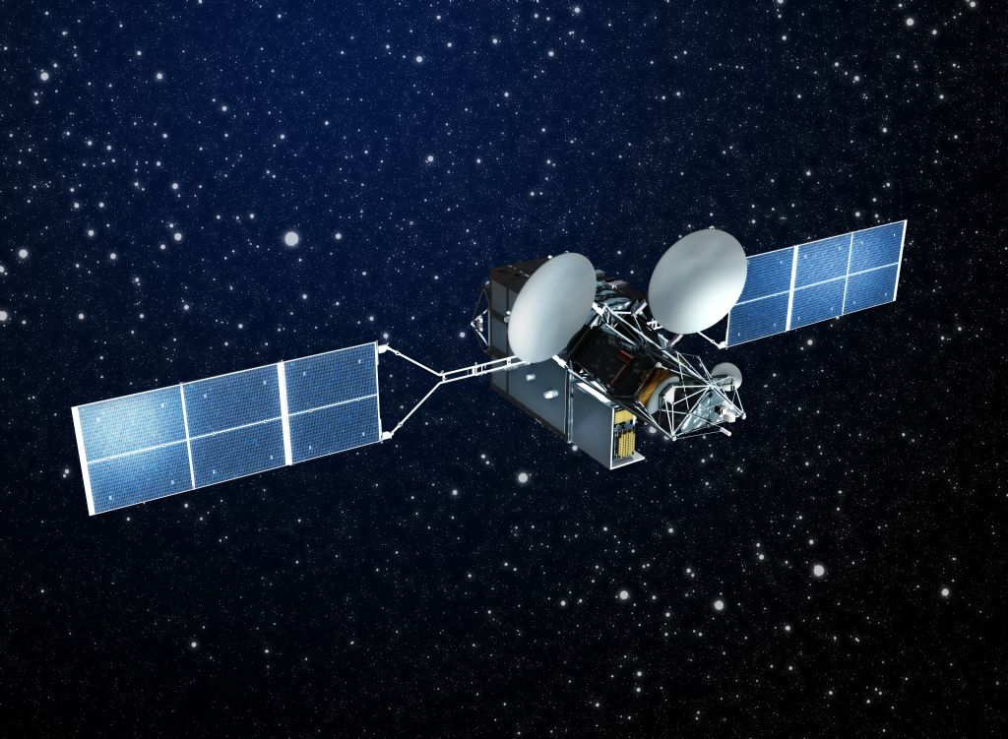
Contact Information
Dustin Young
VP, Channel Sales (t&f) +1.707.283.8018
(m) +1.916.346.6217
Email: dustin.young@x2nsat.com LinkedIn: www.linkedin.com/in/dustinyoung Facebook: X2nSat Facebook Page

