Slide 2
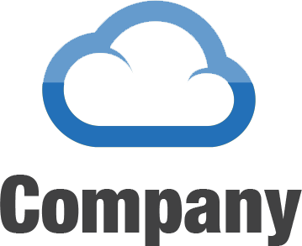
Headquartered in Irvine, CA
Five Years in Business
Cash Flow Positive
100% SLA Guarantee
Data Centers
Irvine, CA
Sterling, VA
Dallas, TX 2013

Slide 3
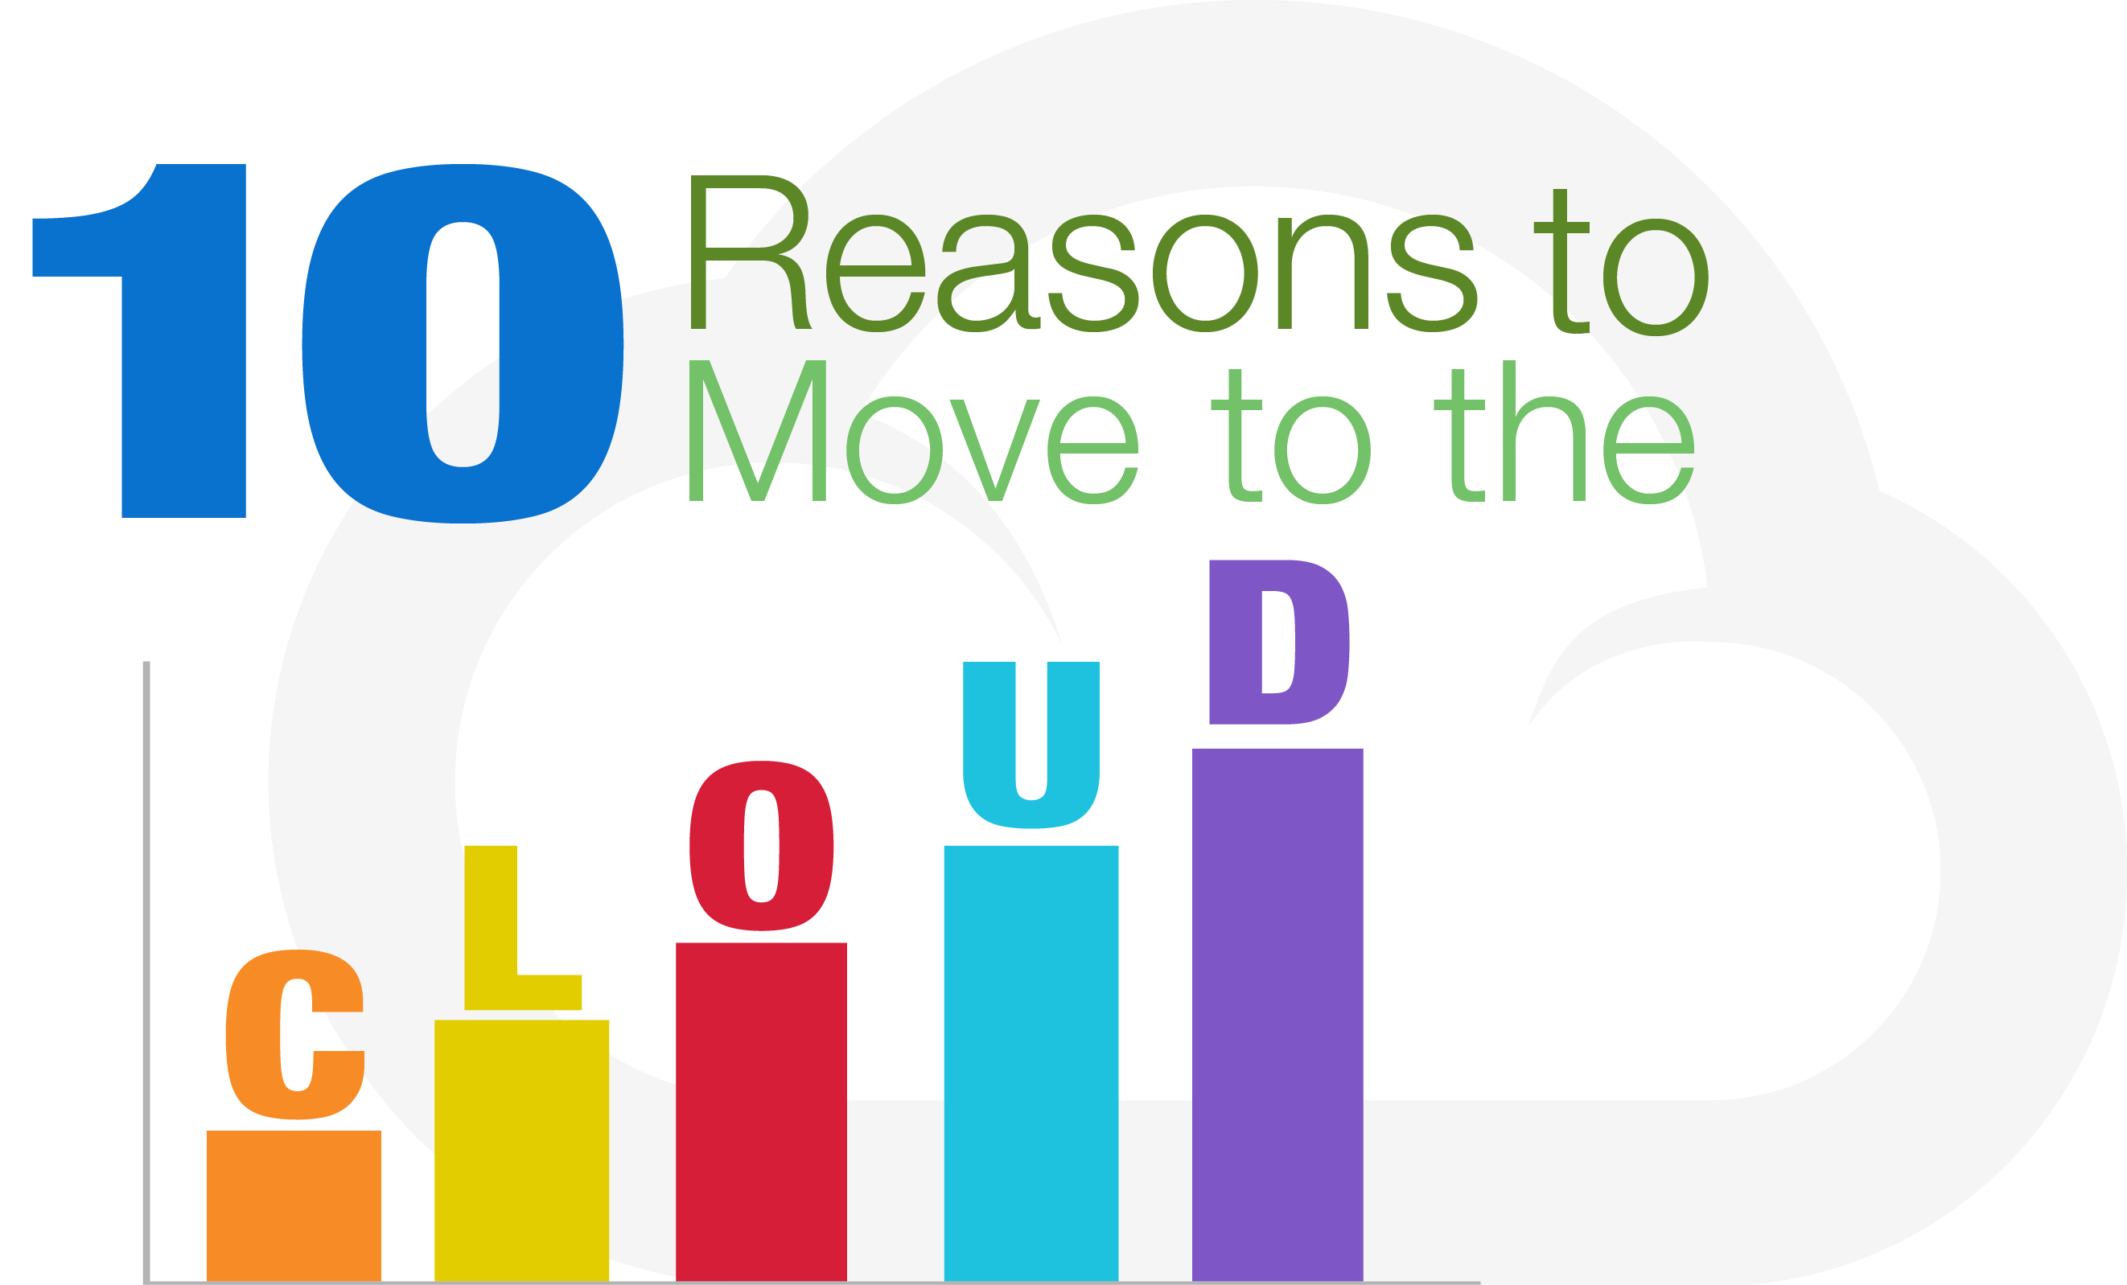

Slide 4
Flexibility

Slide 5
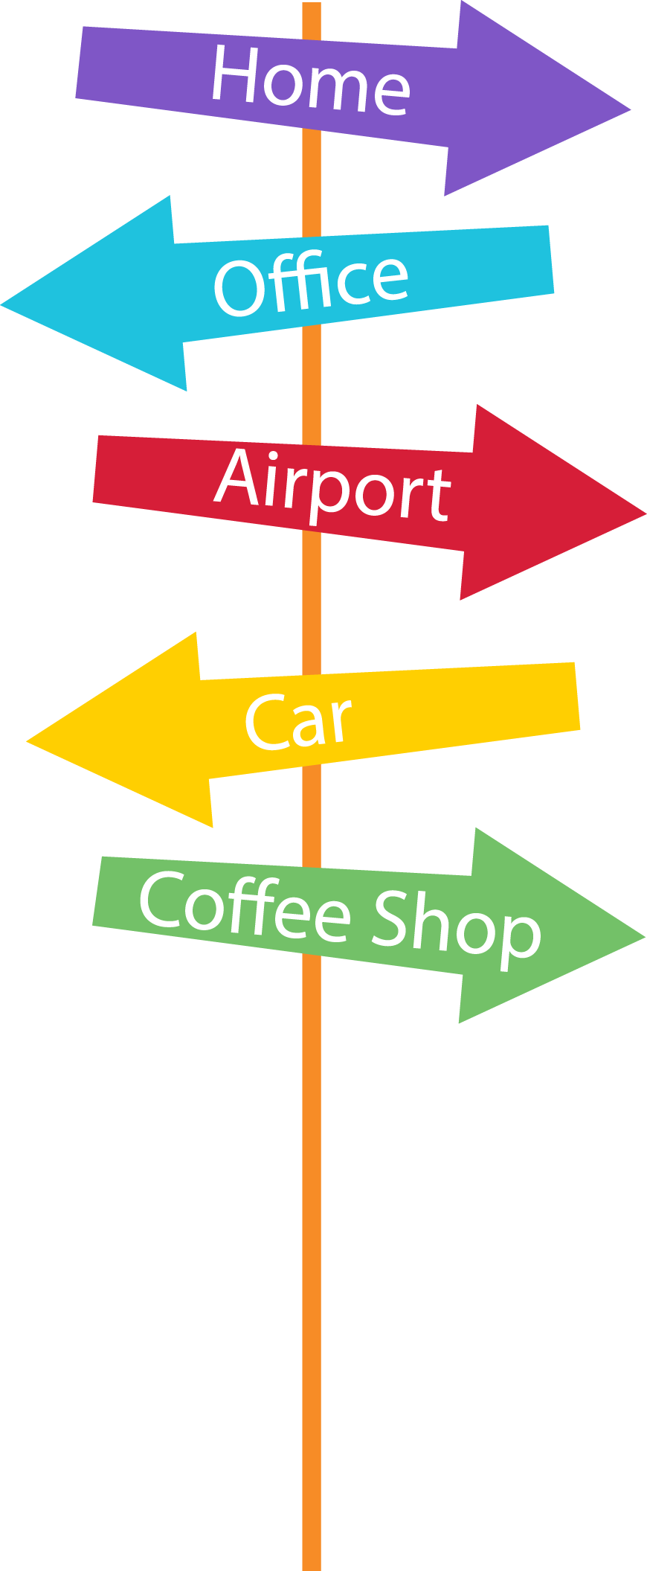
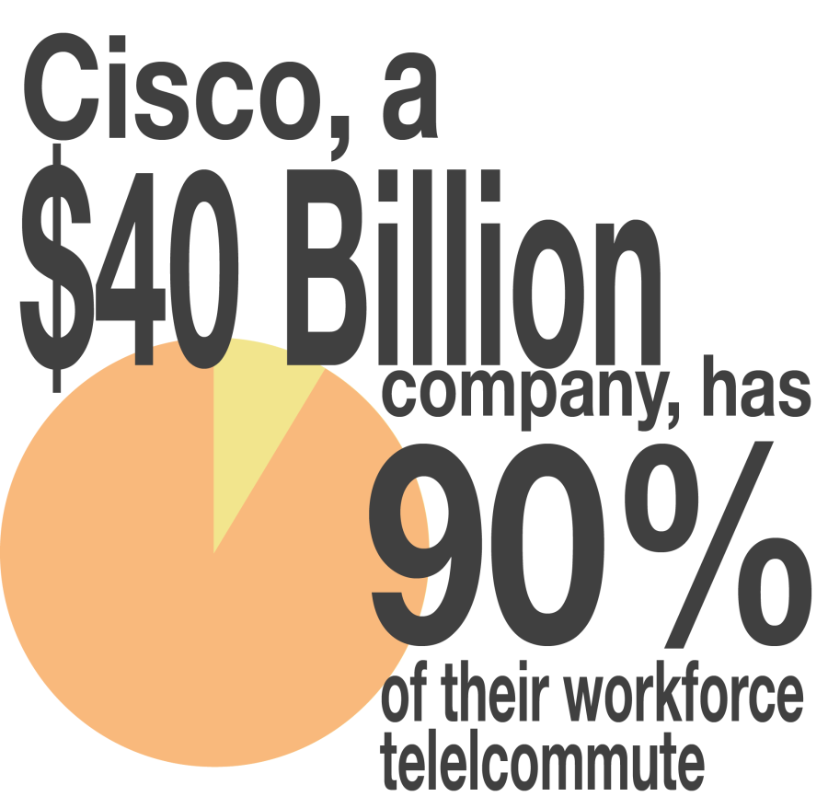
Convenience

Slide 6
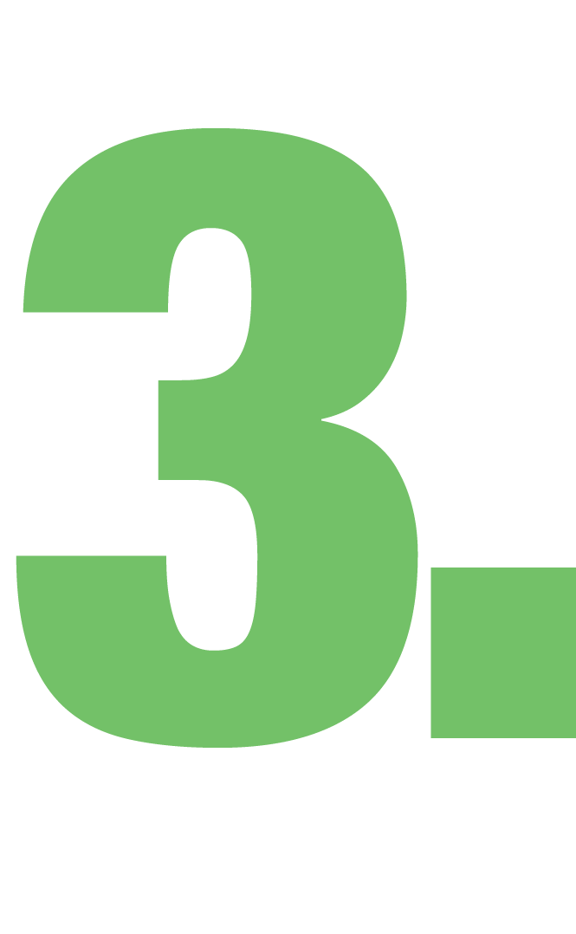
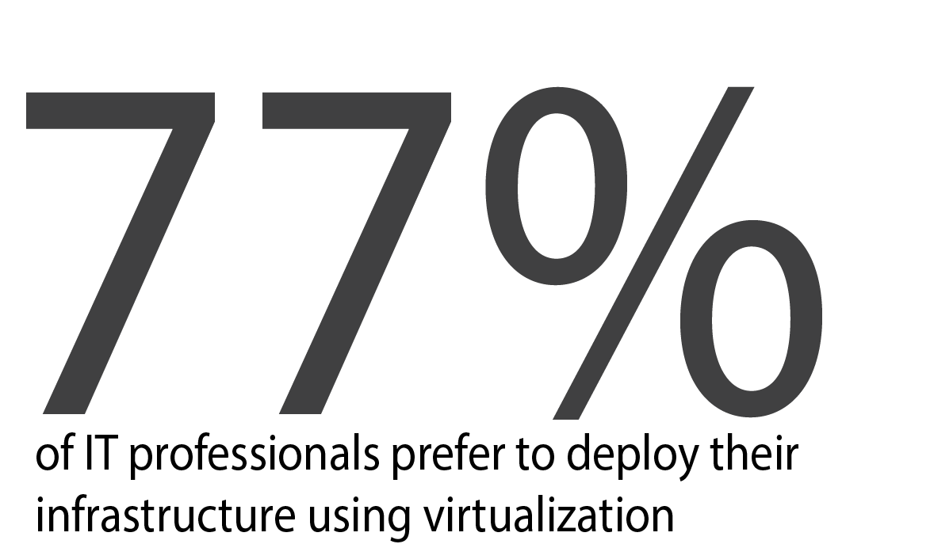
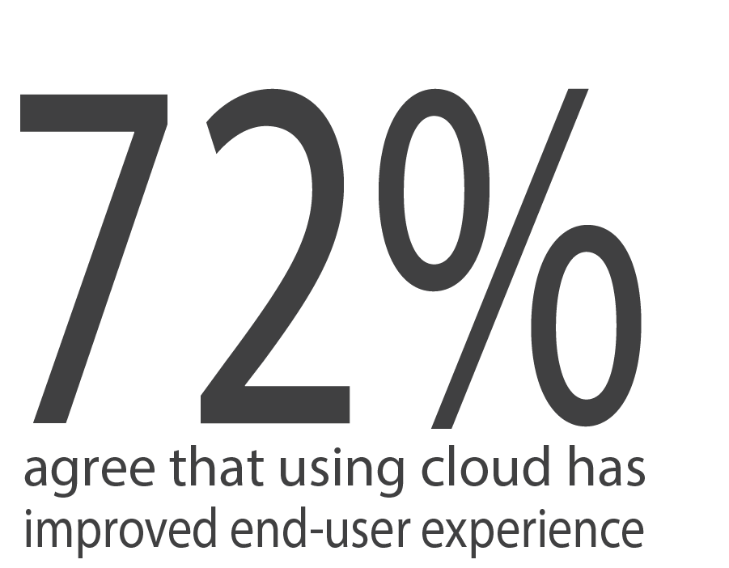
Practical

Slide 7
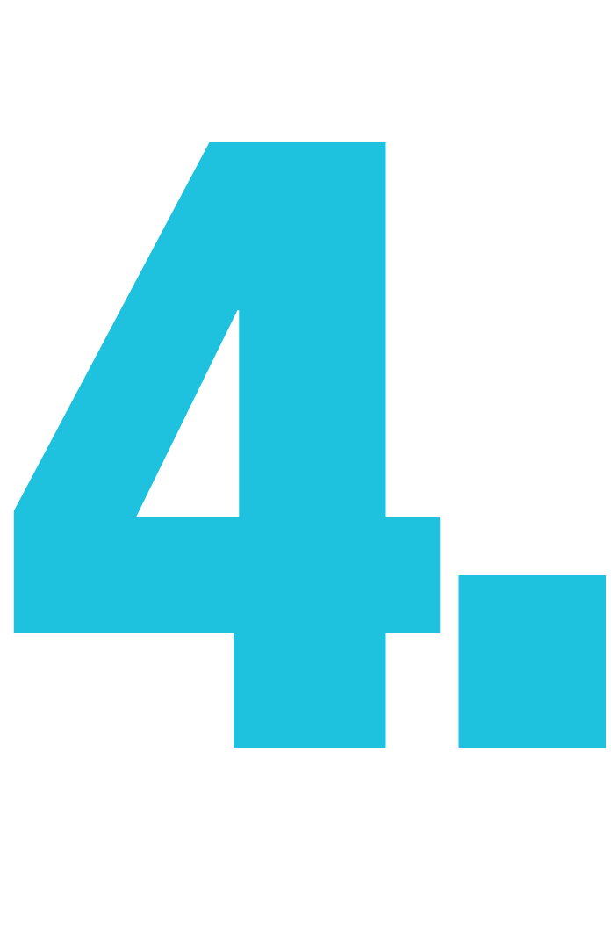
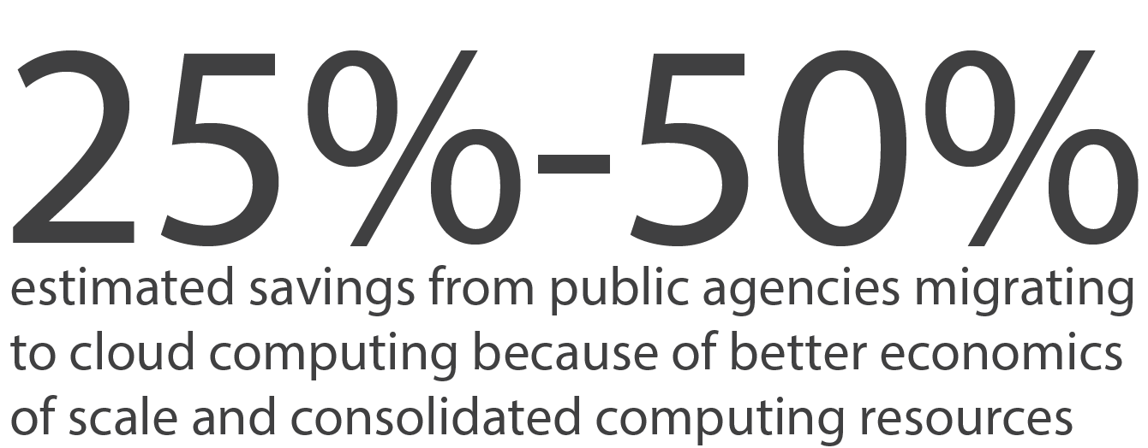
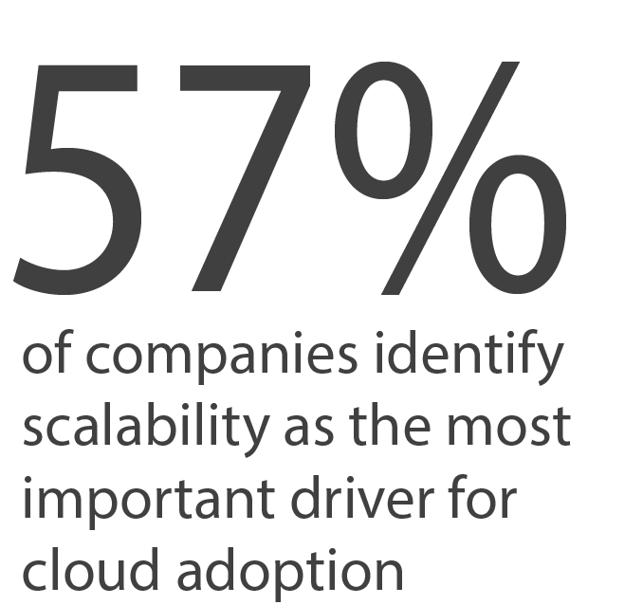
Scalability

Slide 8
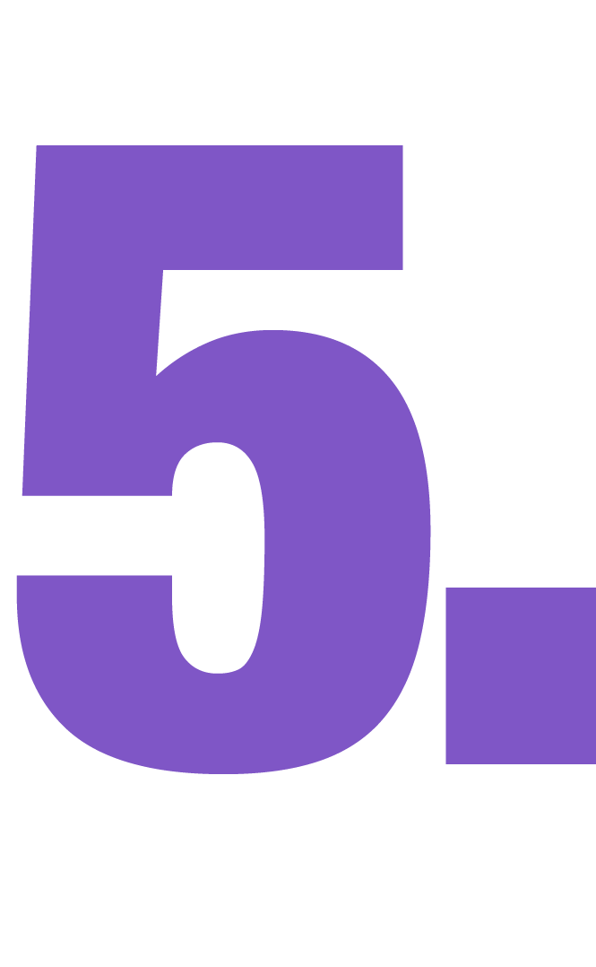
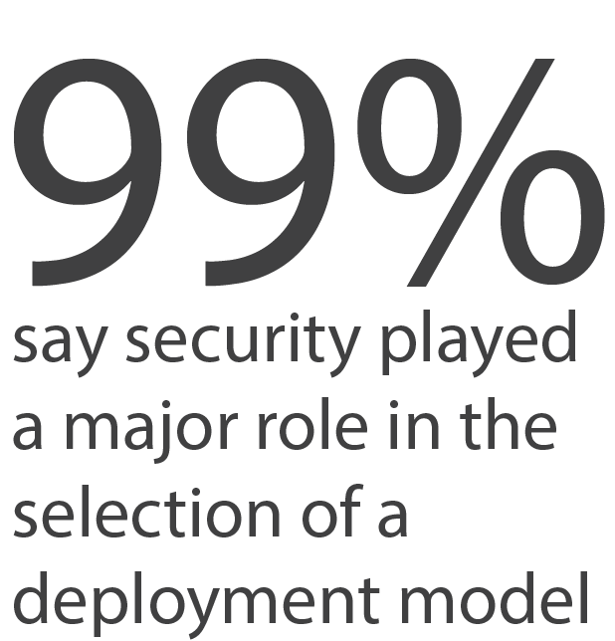
Security

Slide 9
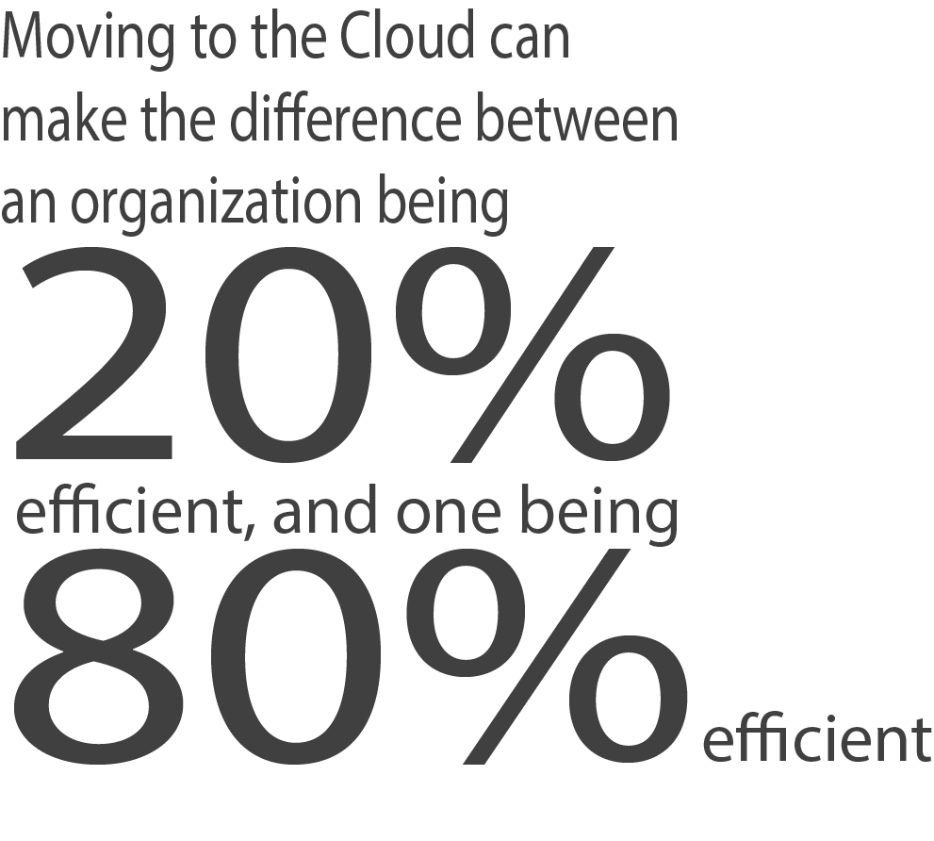
Efficiency

Slide 10
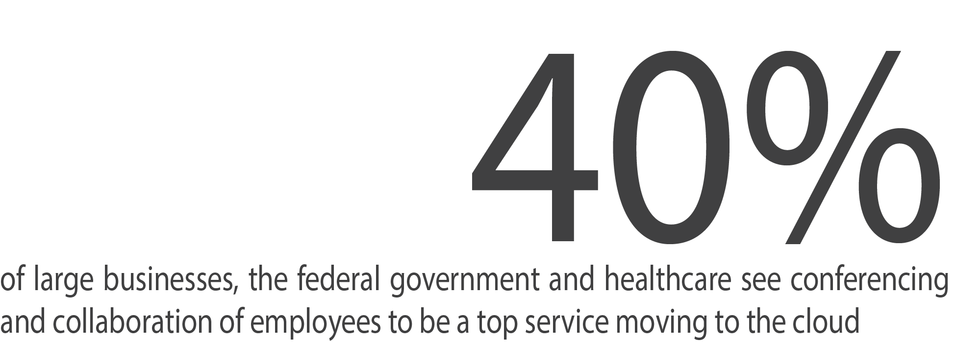
Manageability

Slide 11
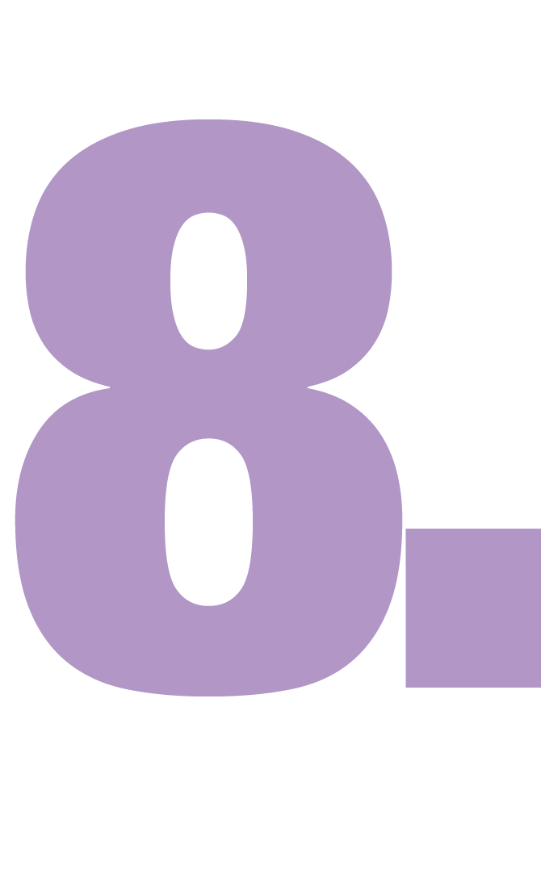
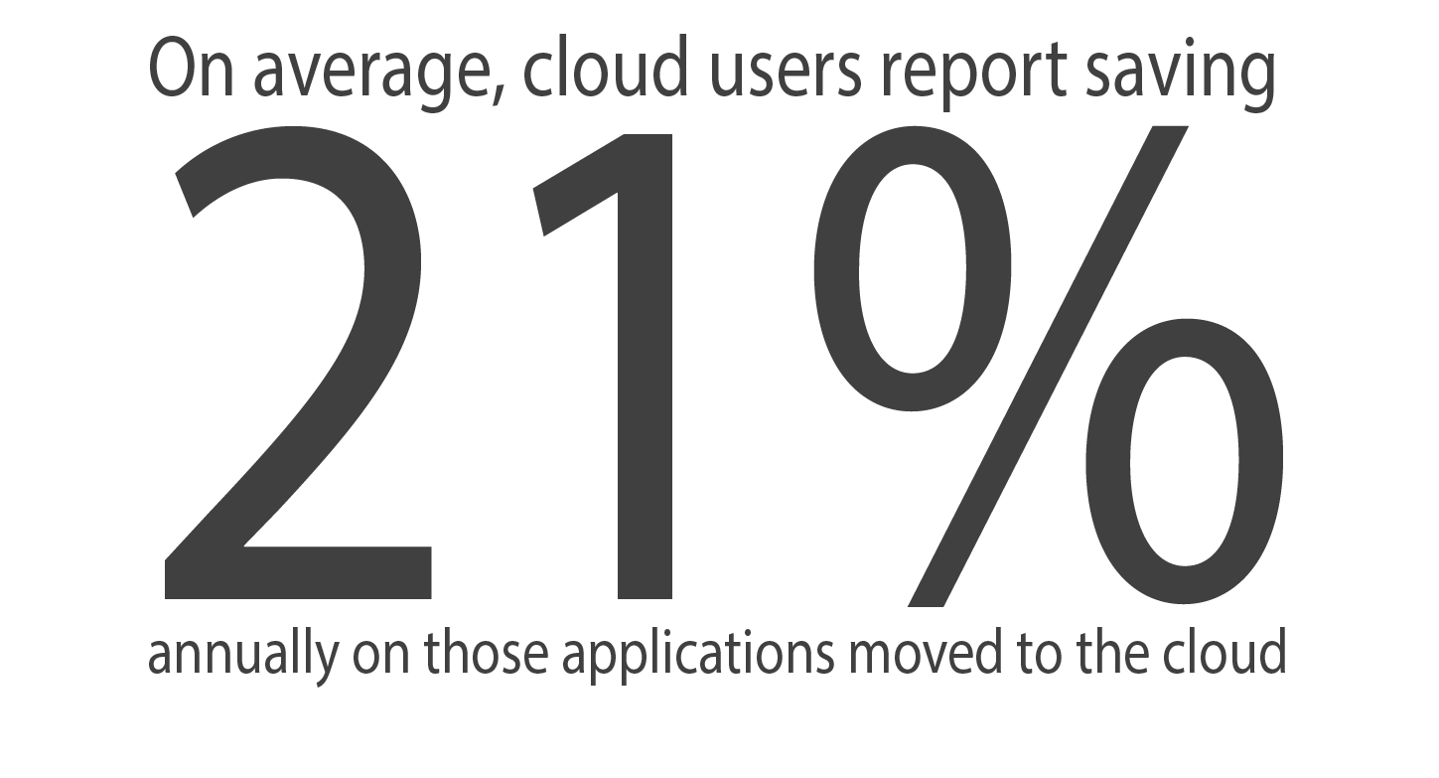
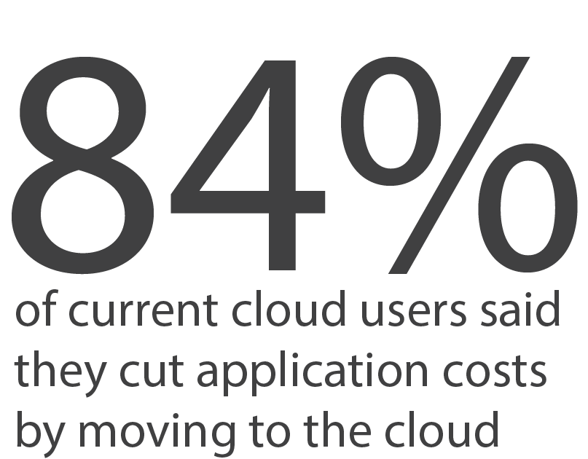
Virtual
Apps

Slide 12
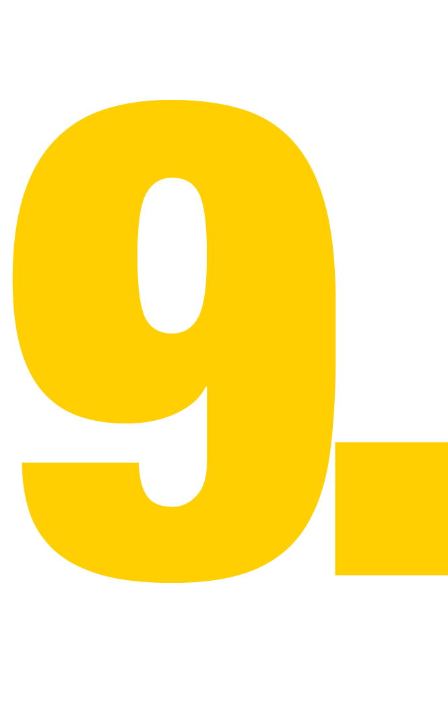
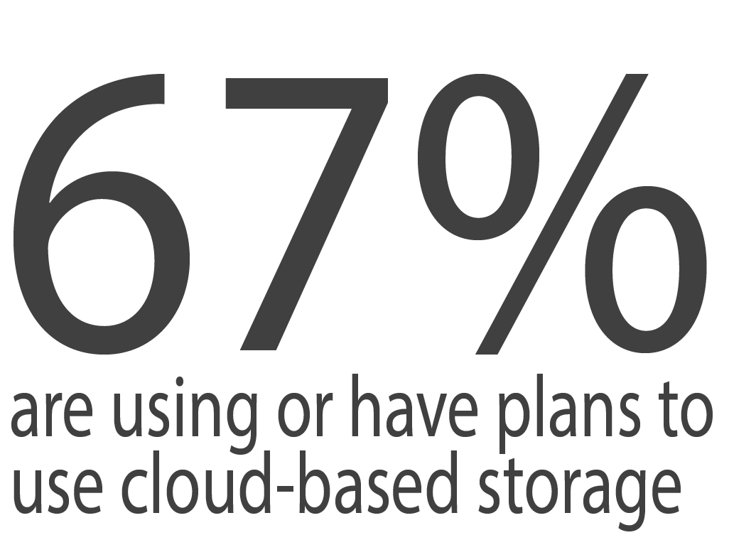
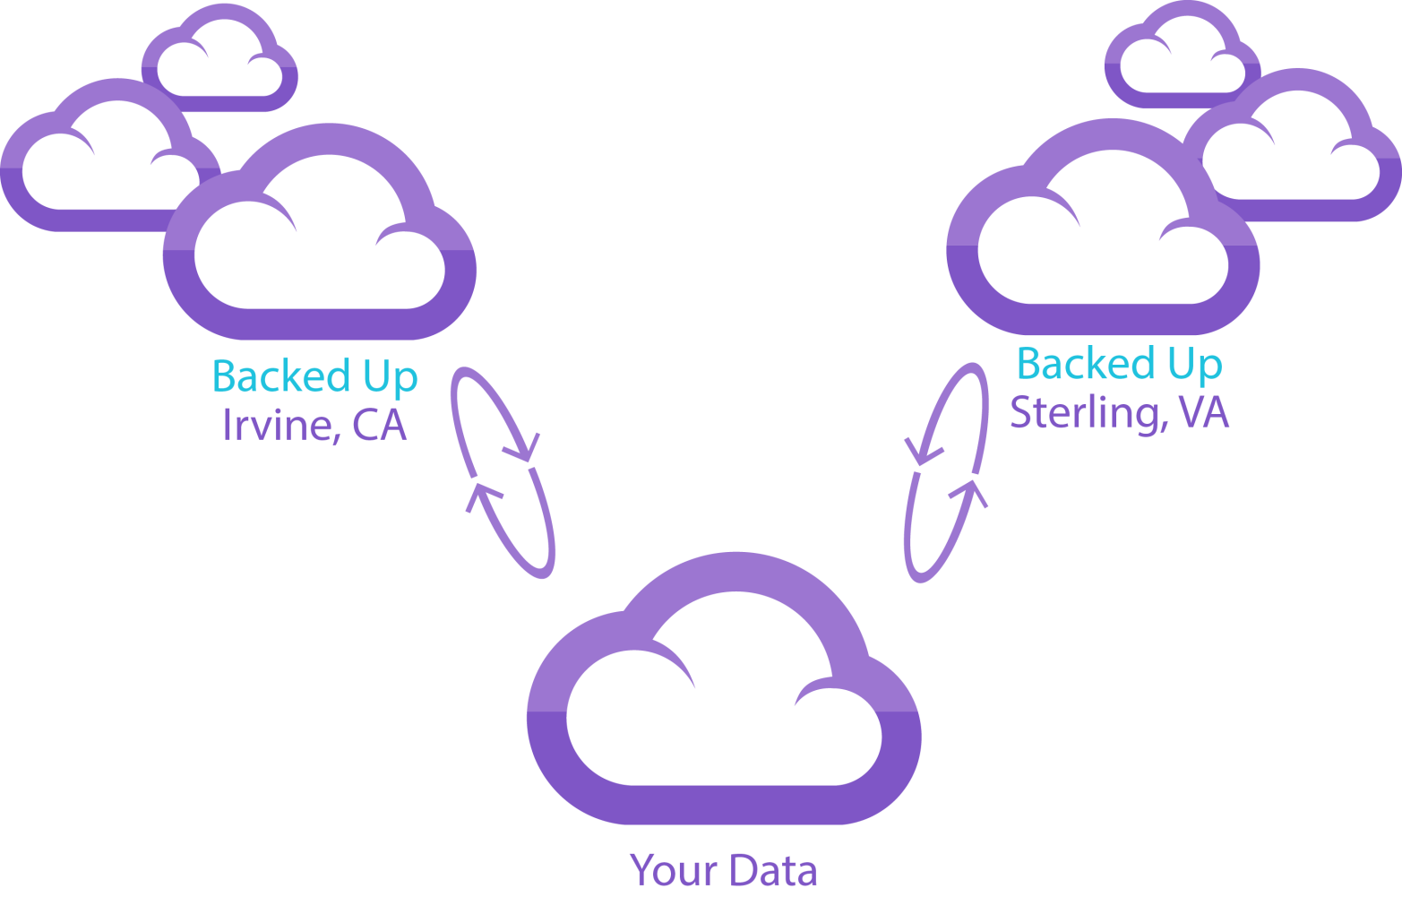
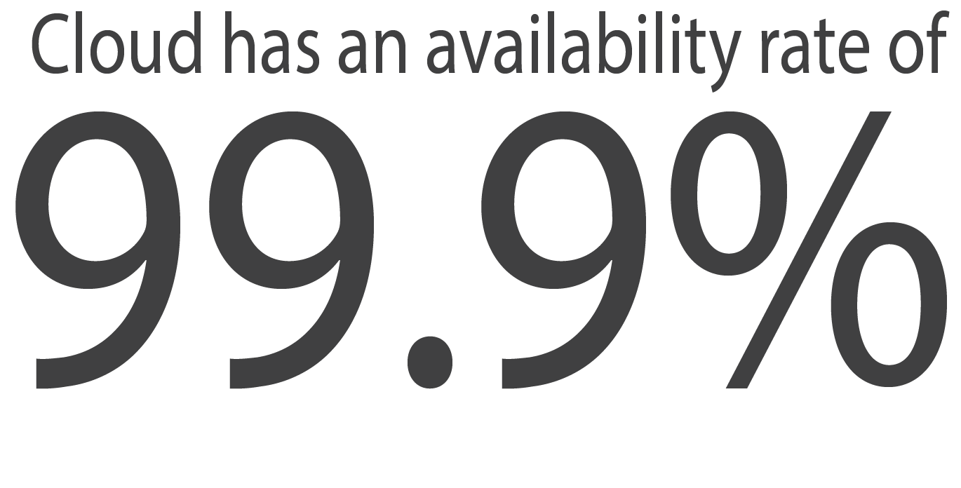
Backup

Slide 13
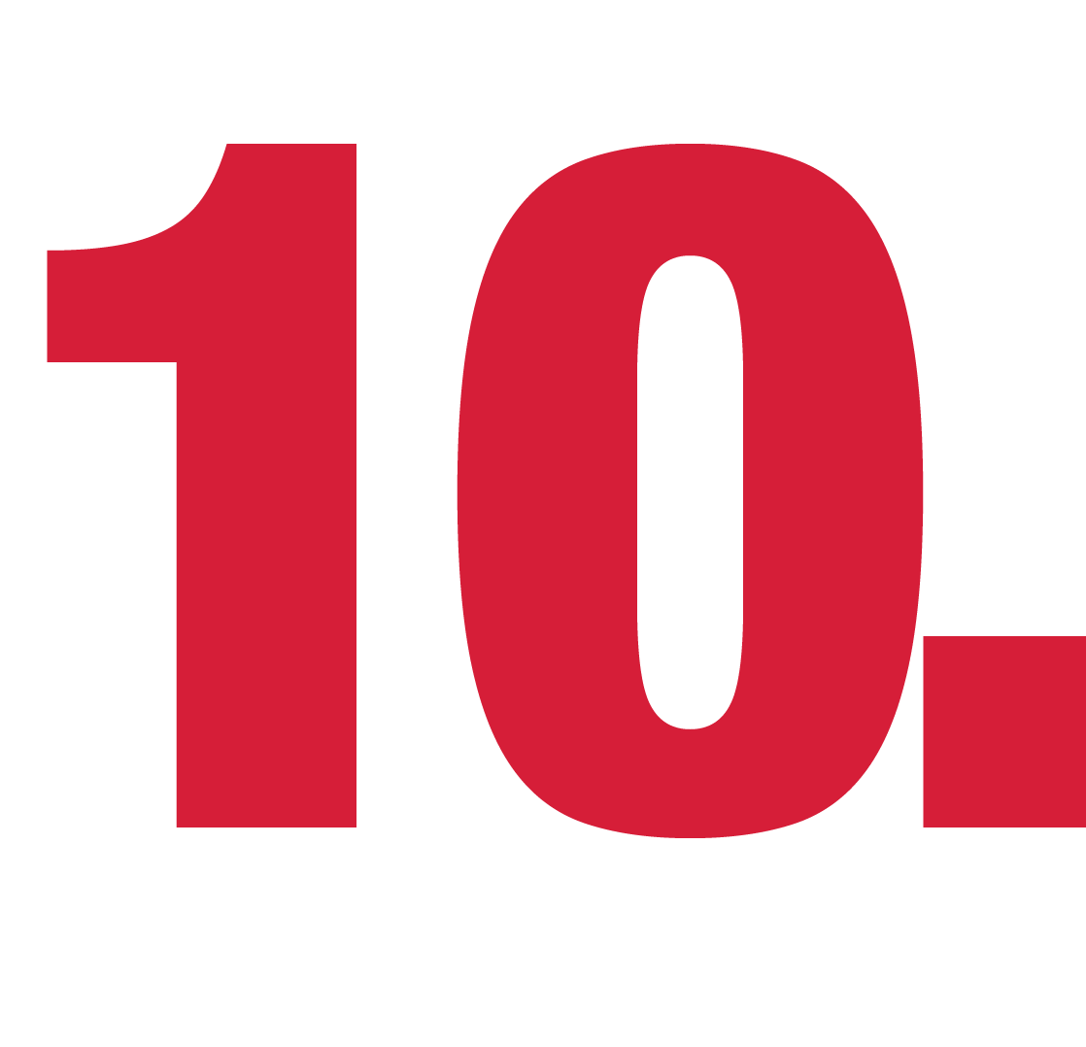
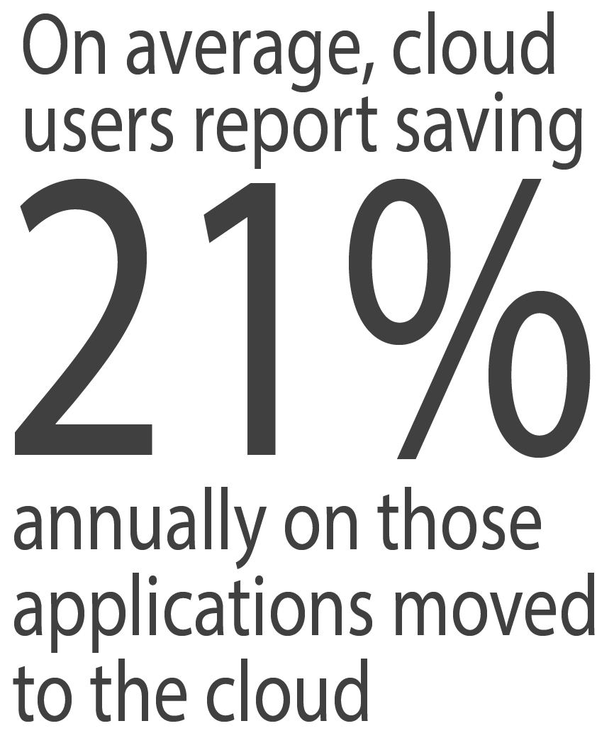
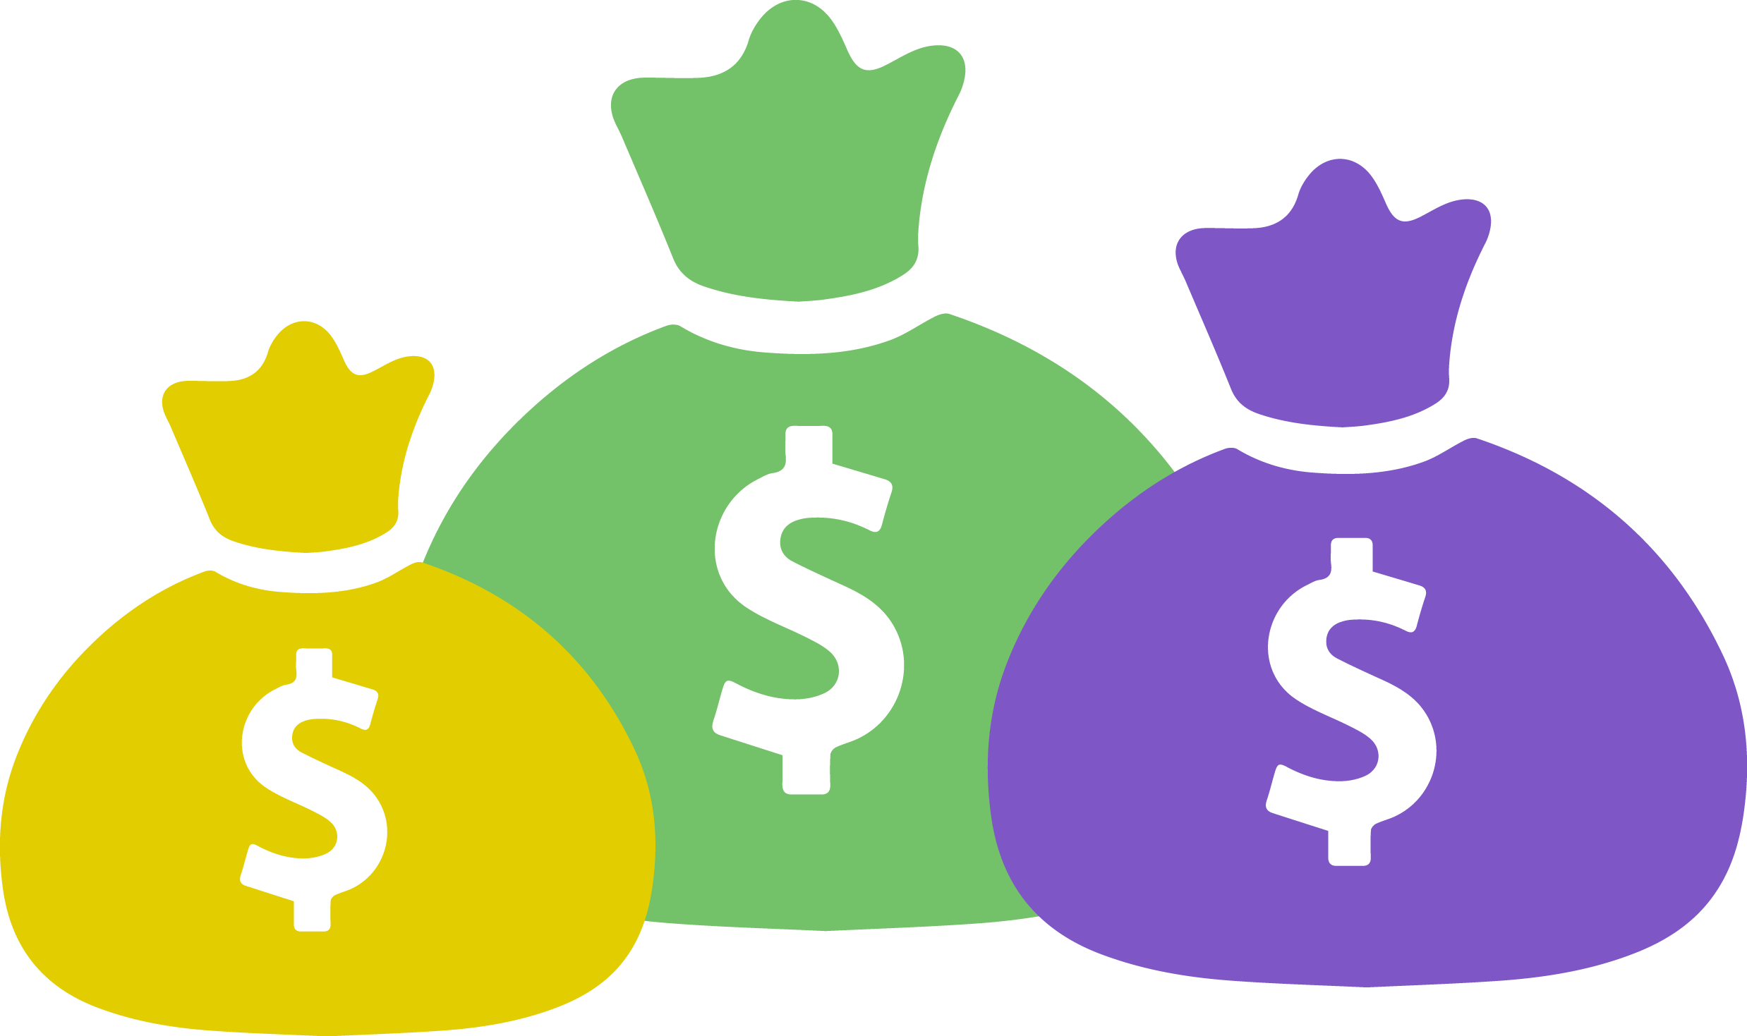
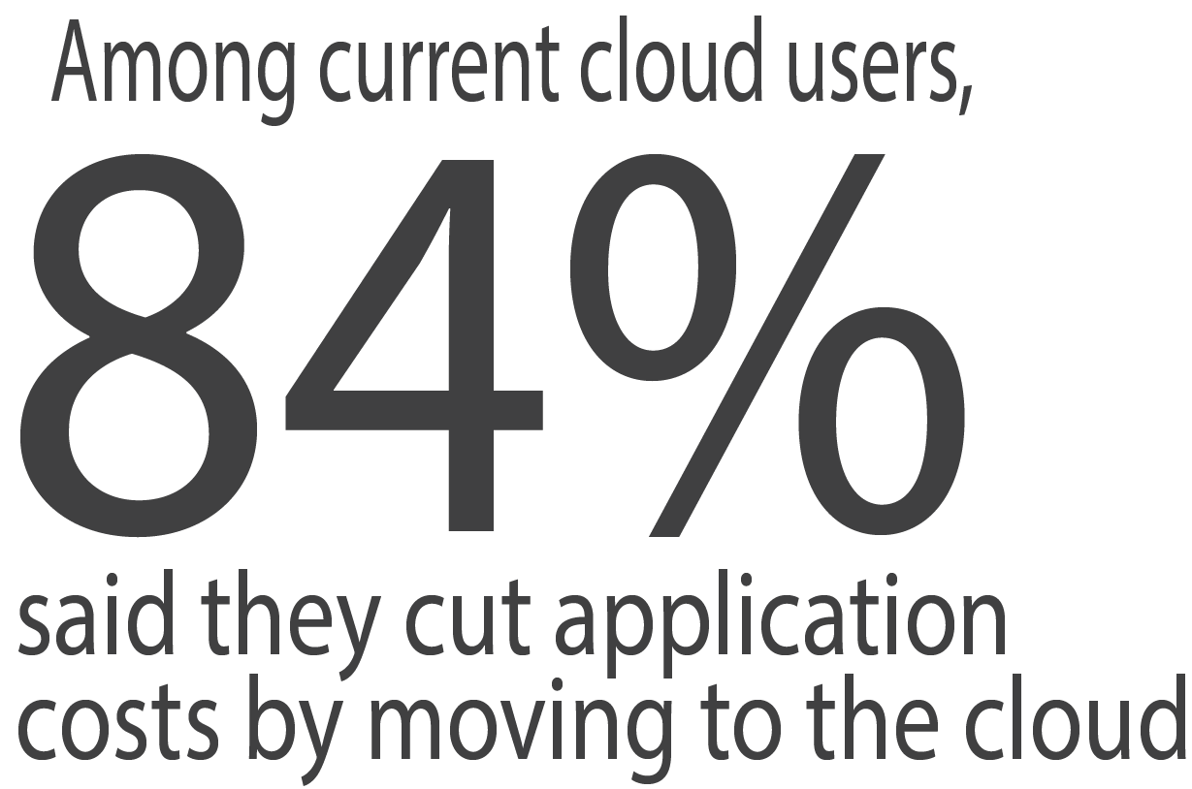
Cost Effective

Slide 14
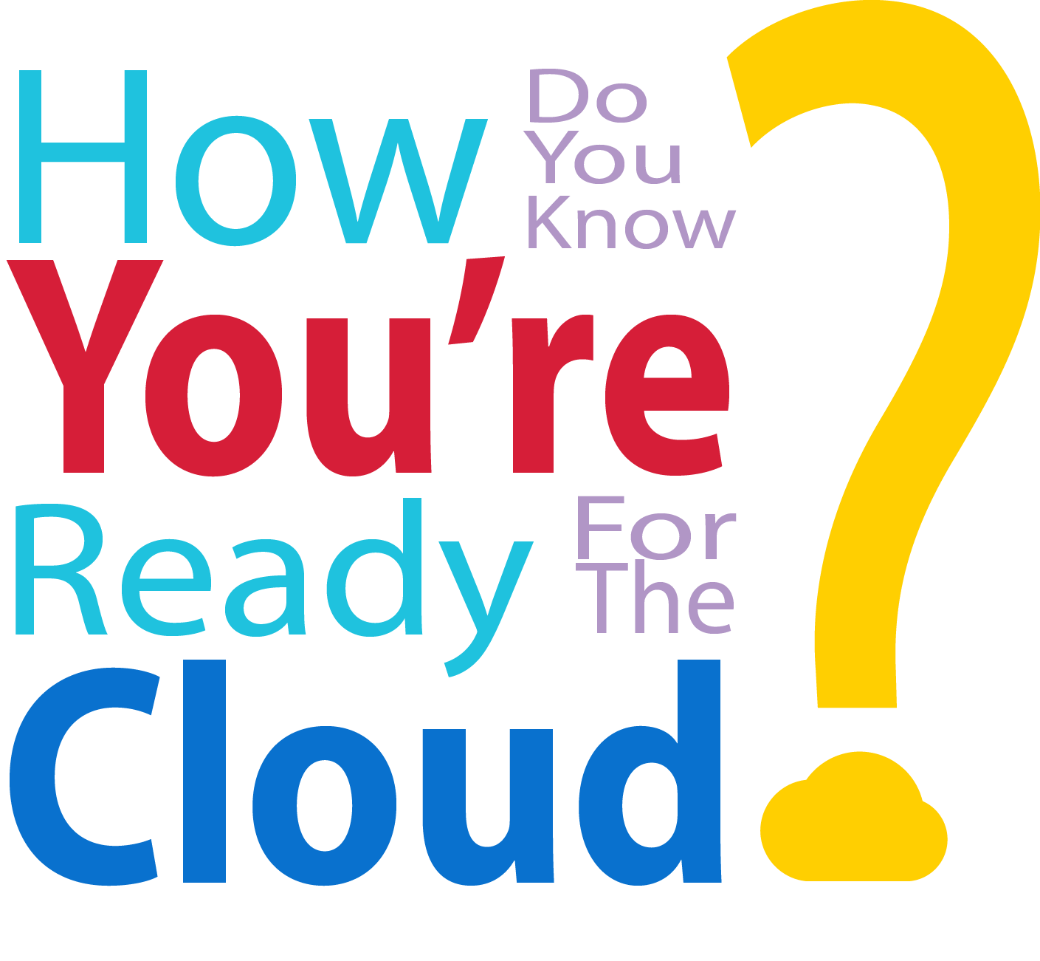
Cost Effective

Slide 15
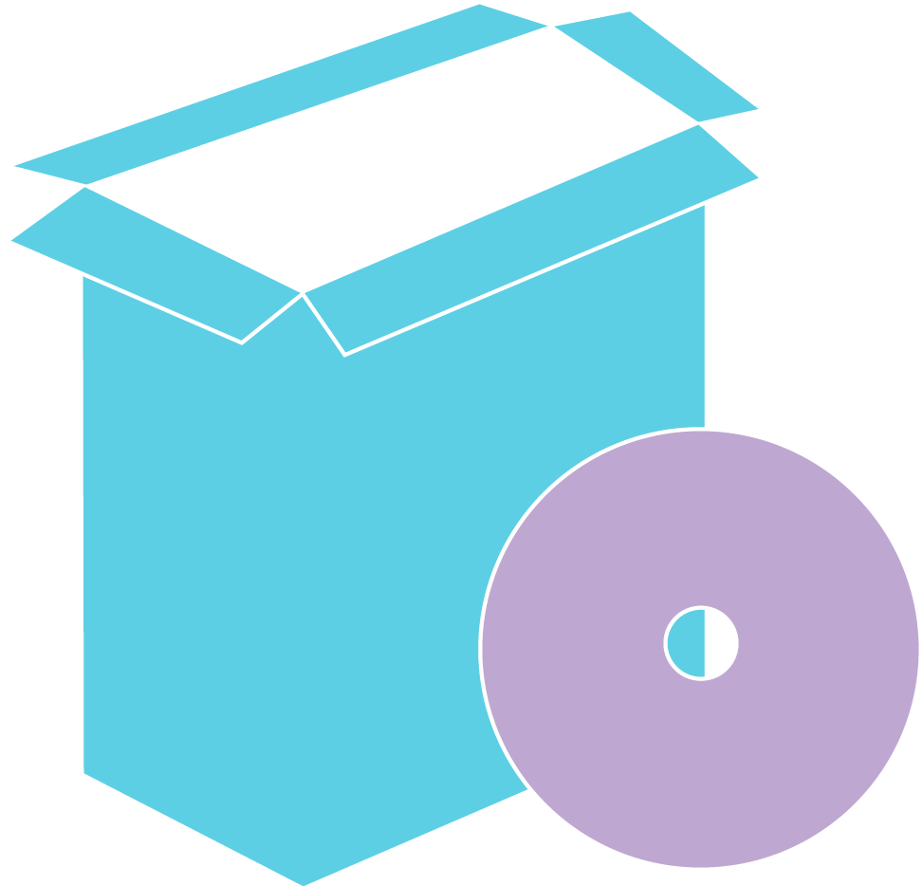
1
Cost Effective
Disaster Recovery/Business Continuity
2
Organization needs new servers/desktops
3
Organization doesn’t have CAPex to upgrade hardware
4
Organization wants to benefit from Enterprise-Level Infrastructure
5
Organizations need to upgrade their Exchange Server
6
BYOD

Slide 16
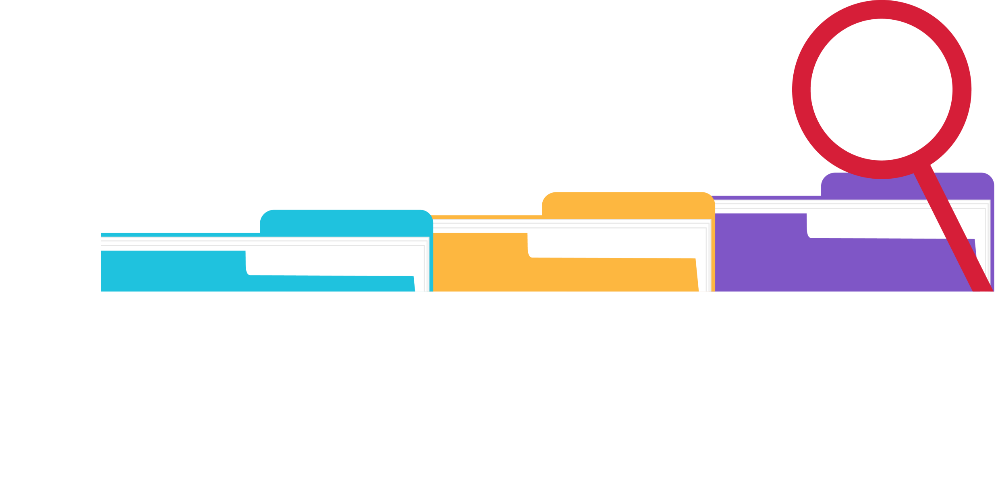
Background:
A 40 employee organization in Southern California that provides service to the manufacturing industry needed to buy a server to load a new application on. They were faced with the challenge of buying the server or moving it to the cloud.
After reviewing the costs of a new server, their MSP brought RapidScale in to provide them with a virtual option. RapidScale provided them with a proposal. After the CFO saw the monthly price for this one application, he asked RapidScale to price out all 4 servers of theirs and also fully virtualize their desktops as well. RapidScale’s price ended up being similar to the price budgeted for that one application.
This organization moved forward with RapidScale in less than a 30 day sales cycle and also bills $4,000 per month with RapidScale. At the same time, they are now upgrading their internet connection to a Fiber connection.

Slide 17
Cost Effective
Homa Popal
714-553-4554
Homa.popal@rapidscale.net
www.rapidscale.net

