Slide 1
June 4, 2013
Notes:
1

Slide 2
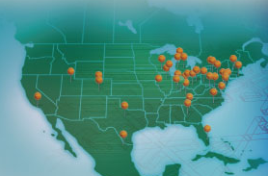
ACC Background
The Leading Expense Management Company
A Cost Reduction Firm
Founded in 1992 – 20 Years
28 US Branch Offices
Over 1,000 clients in 25 different industries
Cost reduction specialists in 35 indirect expense categories.
Gain share — Client pays only when we deliver savings based on fully implemented and audited results.
Independent work effort – ACC completes all work up to implementation. Very Limited time requirement of client’s staff.
Implement, measure and verify savings for 18 months for each category of spend.

Slide 3
The Business Problem
Profit Squeeze
Organizations continue to face:
Revenue pressures from:
The economic downturn
Changes in demand
Fierce competition for fewer sales
Cost pressures
Variable costs have been increasing
Reduced Sales have a negative effect on fixed cost coverage
Projections indicate costs will continue to increase
Both are causing a compound squeeze on profit

Slide 4
The Missed Opportunity
“Mid-sized organizations the US. are losing $134 billion in
missed cost savings
each year due to a lack of expertise and insufficient
purchasing power.”
The Aberdeen Group-- 2009
Notes:
Simply put, we find money for business.
Let me start with our obligatory research statistic. The Aberdeen Group studies our space closer than anyone & they project that small & mid-sized businesses are missing out on $134 billion in cost savings each year due to insufficient purchasing power & a lack of expertise in the areas where they are spending their money.
That’s more than the GDP of 230 countries!!

Slide 5
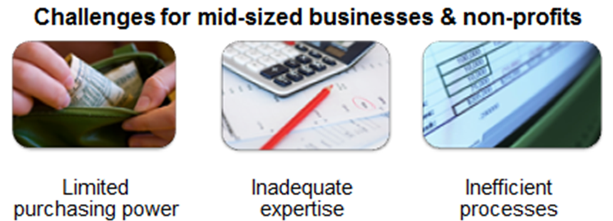
Current State

Slide 6
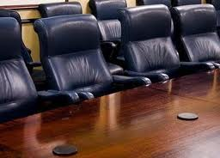
Chief Cost Containment Officer (“C3O”)
A seat at the Executive Table
Generator of profit
Hub of cost intelligence
Vital entry point for suppliers
Long term residual relationships with both ends of the supply chain
Notes:
6
ACC delivers Fortune 100 buying power and expertise to the middle market to for more than 35 non-strategic indirect expenses. We capture the savings, monitor the suppliers and share in the savings for an extended period of time. We establish national group purchasing contracts with vendors that offer steeply discounted pricing and pay us a percentage of the recurring transaction.
The net result is between 10-50% savings on everyday common indirect expenses. This is savings that the client was either unable to achieve or was unaware that it existed.

Slide 7
Indirect Expense Categories
Merchant Card / AP Processing/ Debt Recovery
Printing / Forms Document Management
Telecom / Energy / Payroll Svcs
Freight / Logistics / Express Mail
MRO / Landscaping/ Janitorial
Office Supplies / Packaging / Corrugated / Shipping Supplies
Waste Removal / Service Contracts Contract Services
Fleet Vehicles / Fuel / Forklifts / Pallets & Containers
Insurance / Professional Svcs Staffing / Uniforms Security
Equipment / Computers / More…

Slide 8
Proprietary Methodology
Preliminary Savings Analysis
Letter of Authorization
Data Collection
Request for Proposal Management
Final Recommendation Report
Implementation
Savings Audit & Measurement
Notes:
8

Slide 9
Sample Engagement
Phase 1
Phase 2
Phase 3
2-4 weeks
2-4 weeks
18 months
Utilize proprietary software to manage RFPs & calculate savings.
Intensive review of client spend.
Implement and verify actual savings.
Notes:
9
How do we deliver the savings? It takes approximately 8 weeks to discover the savings and present to our client for implementation. This consists of downloading the clients historical spending activity and using a proprietary software application to manage and calculate the savings offered by the vendors.
One of the more powerful aspects of our model is our savings measurement process. Our savings audit software creates a detailed, itemized savings report for the client each month or quarter and is used to calculate the amount that is due ACC.
Our proprietary methodology is contained in our Operations Manual that we use deliver the savings.

Slide 10
12 month AP File
PURCH-YTD | CATEGORY | NAME
$ 1,087,816.02 | Insurance | AETNA HEALTH MANAGEMENT
$ 386,190.01 | Energy | CHAMPION ENERGY SERVICES LLC
$ 356,049.00 | Insurance | A J GALLAGHER RISK MGT SRV INC
$ 339,842.03 | Packaging | HARRIS PACKAGING CORP.
$ 227,350.14 | Staffing | MAGNUM STAFFING SERVICES
$ 219,475.45 | Staffing | MAGNUM STAFFING SERVICES
$ 219,193.25 | Energy | CENTERPOINT ENERGY SERVICES
$ 158,135.93 | Insurance | BLUE CROSS BLUE SHIELD OF TX
$ 147,175.61 | Packaging | HARRIS PACKAGING CORP
$ 127,754.58 | Chemicals | CUSTOM CHEMICALS OF TEXAS
$ 97,113.47 | MRO | CHAMPION INDUSTRIAL SALES CO
$ 93,345.02 | Energy | ATMOS ENERGY
$ 84,726.30 | MRO | MOBILE FASTENERS
$ 82,511.58 | Staffing | STAFFING SOLUTIONS
$ 79,158.41 | Gases | MATHESON TRI-GAS
$ 73,109.39 | Staffing | J & M STEEL COMPANY
$ 59,238.50 | Welding | METROPLEX SERVICE WELDING
$ 52,230.65 | Freight | UPS
$ 50,269.00 | Freight | EXCARGO SERVICES INC.
$ 49,157.72 | Freight | OLD DOMINION FREIGHT LINE INC
$ 47,283.86 | Nameplate | HOLLAND NAMEPLATE

Slide 11
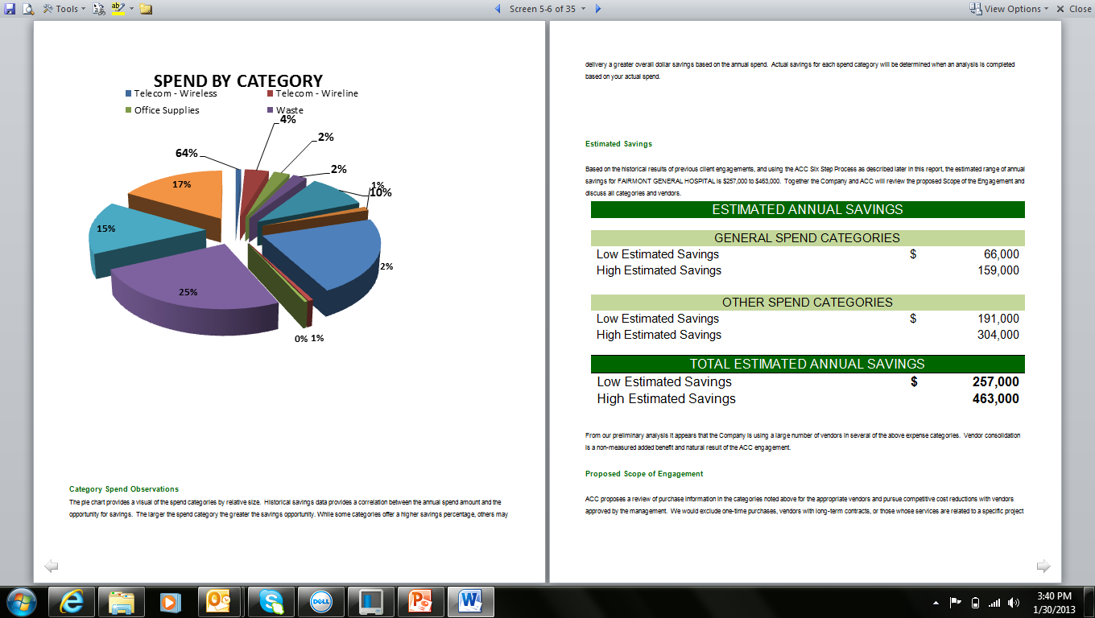
Preliminary Savings Analysis

Slide 12
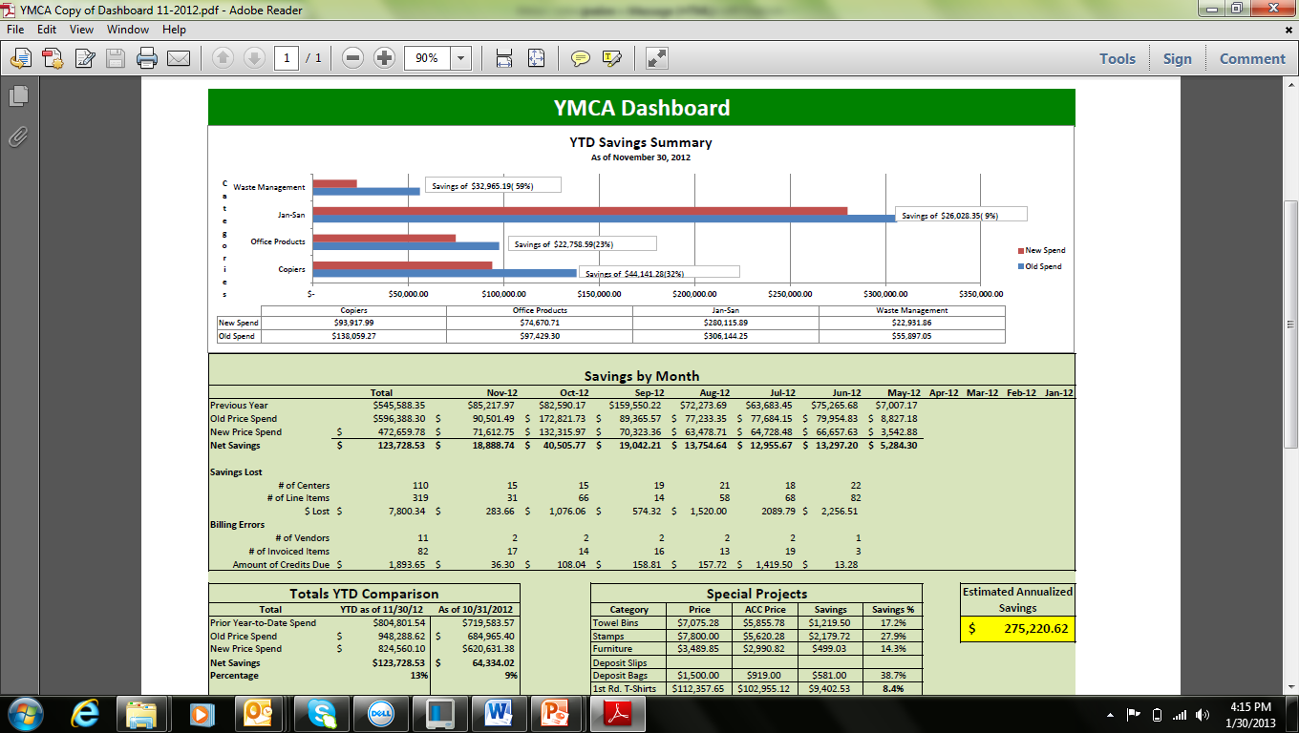
Savings Audit

Slide 13
Qualifying ACC Clients
Criteria | Target
Revenue | $25 Million - $1 billion
# Employees | More than 75
Relationship | CFO, CEO
Industries | Manufacturing Non-Profit Healthcare Professional Services Distribution Other….

Slide 14
Selected Clients
Notes:
Ours is a relationship sale that works best through referrals and channel partners. Approximately 55% of our engagements are initiated through referrals from sources like CPA firms and telecom sales agents. 35% of the engagements come from a lead generation/ telemarketing efforts. We are averaging 2 engagements for every 10 qualified C-level appointments. The balance comes from trade shows, e-marketing & leads that come through our website.
Although we have a presence in over 25 industries, we have identified 7 vertical markets, where we intend to accelerate our marketing efforts with this funding round. To give you an idea of how much potential is out there, lets examine the Convenience Store industry. We have closed 8 engagements in the past 12 months alone, and are currently averaging $3,000 per store. If you extrapolate that out across the 144,000 stores, you will find there is $400 million in indirect cost savings in the US C-store market. That amounts to $200 million in gain share revenue and $40 million in recurring development fees. That’s just one vertical that we are starting to dominate, we are eexperiencing similar successes with non-profits and asisted living centers. The Convenience Store News, the largest trade journal in the industry is running a big feature on ACC next month to coincide with the Annual Conference.
To find franchisees, we advertise on franchise portals and executive job boards to attract new franchisees; however, the most qualified franchisees find us through the search engines.

Slide 15
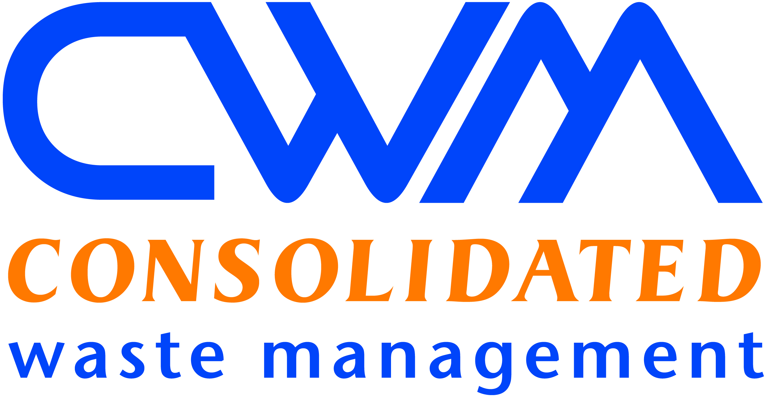
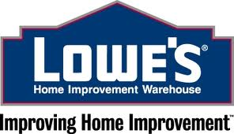
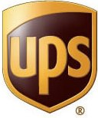
ACC Vendors

Slide 16
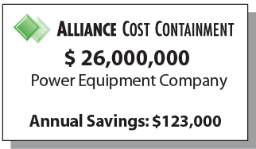
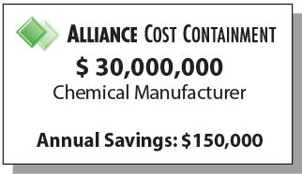
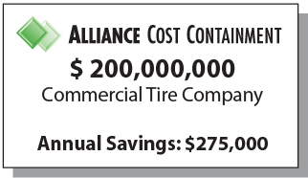
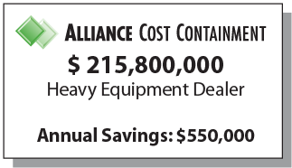
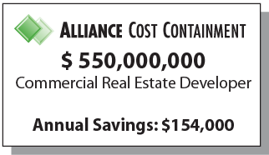
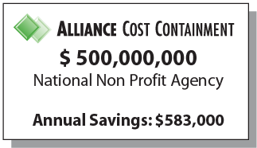
Case Studies

Slide 17
ACC Advantage
Experience
20 years in the Industry
28 Branch Offices, >1000 clients
Proprietary and proven Benchmarking, RFP & Auditing processes
National contracts
Strong Executive team - experienced subject matter experts
Process
One of the only firms that manage over 35 categories of spend
Exclusive Central Services for managing data, vendors and audits
Fast results (approximately 8 weeks)
Proprietary Data Base of vendors, costs and results
Results Guaranteed
Preliminary savings analysis sets expectations
Contingency Based– fees based on performance

Slide 18
Next Steps
Obtain YTD Supplier Spend Report
Conduct Preliminary Analysis
Meet to Review Analysis and Scope
Execute Engagement Letter
Notes:
18

Slide 19
Thank You - Q&A
Bruce Dawson
SVP Western Region
Office: 303-774-7811 x 201
bdawson@alliancecost.com
John Singerman
SVP of Business Development / Principal
502-523-7020
jsingerman@alliancecost.com

