Slide 1


Slide 2
1
About OSI
2
Services Overview
3
Getting Started
4
Case Study
5
Questions

Slide 3
About OSI

Slide 4



company
Business Process Outsourcing (BPO)
Operating Since 2009 – Profitable and Well Funded
Average Annual growth of 140%
Central American Based (El Salvador, Nicaragua & Panama)
Skilled Administrative BPO Services & Contact Services
High Level of Customer Control and Contact
English Spoken With a Neutral Accent

Slide 5

headquarters
OSI HQ Located in the Heart of the Prestigious
Antiguo Cuscatlán District,
San Salvador, El Salvador
Walking Distance From US Embassy
On-Site Banking &
Food Services
4-Star Hotels Nearby
State-of-the-Art
Technology Infrastructure

Slide 6

work environment
Class A Office with Security
Cubical Work Station with 2 Monitors (Windows OS)
Microsoft Office
Local UPS along
Mobile Phones Available (Optional)

Slide 7


our commitment
Strict Confidentiality with “Local Presence Feature”
Educated and Qualified “Near-shore” Services
That Compliment Your Operations
Dedicated Resources – Your Employees, Your Way
Career-Minded Hard-Working Staff
Flexibility to Scale Efficiently

Slide 8


benefits
No Currency Risk
Operating in the US Central Time Zone
Large Pool of Skilled Workforce
Expert in Local Labor Laws
Robust Access of Recruiting Expertise, Experience and
Database
Leverage of Dynamic Cost Saving Model Without
Quality Sacrifice

Slide 9
Services

Slide 10

services overview
OSI is Dedicated to the Outsourcing of Educated
and Talented Employees
As Much Control As You Require
Know That You Have the Best by Being Involved
Turnkey Labor Law Compliance
Local Background Check On All OSI Staff Members

Slide 11

services platform
Inbound Services
Outbound Services
Telecom Infrastructure
High Availability Hosted VoIP
Premise Based PBX
Full ACD Call Reporting Matrix
Call Recording
Predictive Dialer
Multi Carrier US Dial Tone
Geographically Diverse Internet Connections
Document Management
US Lockbox
Mail Handling
Scanning Services
24/7/365 On-Site IT Staff

Slide 12
services matrix
Technology Services
NOC support
Help Desk
Project Management
Sales Support Services
Lead Gen
Quality Assurance
Account Management
Accounting and Finance
AP/AR
Payroll
Billing
Revenue Assurance
Medical Support Services
Patient Interview
Reception
Insurance Verification
Operations Services
Project Management
Event Coordination
Human Resources
Administrative
Corporate Expense
Social Media/SEO
Virtual Assistant
Customer Support
Customer Service
Customer Survey
Customer Win
Virtual Assistant
Executive Assistant
Administrative Assistant
Human Resources
Real Estate
Telecom

Slide 13
Getting Started

Slide 14

pricing model
Salary Includes
  176 hours per month - 44 hours per week
  All Taxes and Governmentally imposed
  Employee Benefits
  100% dedicated employee
  Office Infrastructure and Oversight
  Human Resources and Time reporting
Available Options
  Graveyard Schedules
  Overtime
  Other languages
  (English and Spanish included)

Slide 15

recruiting
  In-house Recruiting Team
  Dedicated to Finding the Best Candidates
  Job & Behavioral Descriptions Developed
  Deep Relationships with Technical Schools
  and Universities
Channel of Outside Recruiters
Detailed Prescreening, Testing &
Background Check Process
Only Best Candidates Presented
Customer Review Final Step
for Dedicated Team
Onboarding

Slide 16

outsourcing options
Outsource All Functions
  Customer Service & Accounting
  Virtual Assistant
Partial Outsourcing
  Keep Some Functions in the US
  Move Others to Central America
Temporary Outsourcing
  Examples include: Campaign & M&A
  Short-Term Task Forces

Slide 17
Case Studies

Slide 18

your real cost
Salary
Taxes, Benefits and Healthcare (17%)
H/R , Payroll, Mgmt Function (Varies)
Real Estate (150 Sqft)
FF&E – Computer, Phone, Desk, Chair ($1,500/employee)
Services – Dial tone, Internet, Utilities ($50/employee)
Office Services – Beverages, Beverage Equipment & Paper goods (Varies)
Employee Risks (Varies)

Slide 19
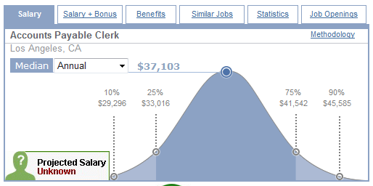
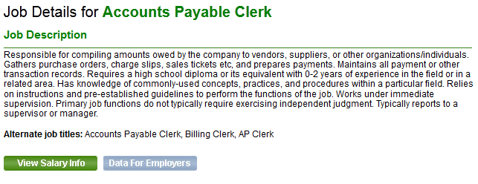
accounts payable

Slide 20
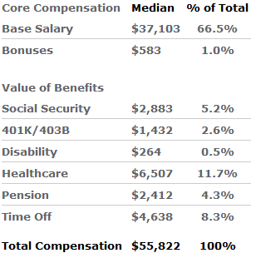
your total cost
The Economics
Excluding Office Space, FF&E, Voice and Data Services, Payroll, H/R and Oversight

Slide 21
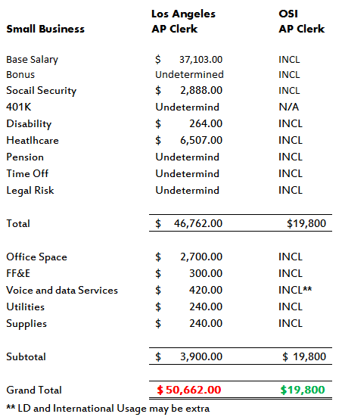
Up to 70% Savings

Slide 22
other examples

Slide 23
“Work is what you do, not where you do it.”
~President Barack Obama

Slide 24
QUESTIONS

Slide 25
Thank You!

